Slide 1
Welcome to Technical Bootcamp: Day 2

Slide 2

A look into the Day 2 agenda:
Day 2
Design Presentations: DW Optimization
Break
Please refer to the descriptions below for reference
Build Hands-on: DW Optimization Part 1
Types of activities:
Attendees will participate in four different types of activities:
Breakout Activity: DW Optimization
Design Presentation: DW Optimization Part 2
Keynote
Labs
Break
Build Hands-on: DW Optimization Part 2
Presentations
Challenges
Breakout Activity
Long Break
Location of activities:
Each activity will take place in the following location:
Design Presentation: Security
Breakout Activity: Security
All-up Session: Teams bridge in calendar invite
Build Hands-on: Security
Breakout Activity: “Meet Now” function in Teams Table Group channel
Closing
Independent working time: No meeting, working in Spektra labs

Slide 3
DW Optimization

Slide 4

Agenda
1 Table design
Distributions and partitions.
2 SQL Capabilities
Windowing, approximate count, group by and JSON support.
3 Performance Patterns
Best practice patterns for performance.
4 Perf Anti-Patterns
Counterexamples that negatively impact performance.

Slide 5

Azure Synapse Analytics
Limitless analytics service with unmatched time to insight
Artificial Intelligence / Machine Learning / Internet of Things
Intelligent Apps / Business Intelligence
Designed for analytics workloads at any scale
Synapse Analytics
SaaS developer experiences for code free and code first
Experience
Synapse Analytics Studio
Platform
Multiple languages suited to different analytics workloads
MANAGEMENT
Languages
MANAGEMENT
SQL
Python
.NET
Java
Scala
Integrated analytics runtimes available dedicated and serverless
Synapse SQL offering T-SQL for batch, streaming and interactive processing
Apache Spark for big data processing with Python, Scala and .NET
SECURITY
Form Factors
SECURITY
DEDICATED
SERVERLESS
MONITORING
Analytics Runtimes
MONITORING
SQL
METASTORE
METASTORE
DATA INTEGRATION
Integrated platform services for, management, security, monitoring, and meta-store
Azure
Data Lake Storage
Common Data Model
Enterprise Security
Optimized for Analytics
Data lake integrated and Common Data Model aware

Slide 6

Comprehensive SQL functionality
Advanced storage system
Columnstore Indexes
Table partitions
Distributed tables
Isolation modes
Materialized Views
Nonclustered Indexes
Result-set caching
T-SQL Querying
Windowing aggregates
Approximate execution (Hyperloglog)
JSON data support
Score machine learning models in ONNX format
Complete SQL object model
Tables
Views
Stored procedures
Functions

Slide 7


Question…
What is the primary factor for Azure Synapse winning a POC?
What about losing a POC?
Notes:
Answer: PERFORMANCE for both! A well designed and optimized Azure Synapse can blow away the competition but falling prey to common performance pitfalls can hurt our chances.

Slide 8
Table design

Slide 9
Tables – Distributions
CREATE TABLE dbo.OrderTable
(
OrderId INT NOT NULL,
Date DATE NOT NULL,
Name VARCHAR(2),
Country VARCHAR(2)
)
WITH
(
CLUSTERED COLUMNSTORE INDEX,
DISTRIBUTION = HASH([OrderId]) |
ROUND ROBIN |
REPLICATED
);
Round-robin distributed
Distributes table rows evenly across all distributions at random.
Hash distributed
Distributes table rows across the Compute nodes by using a deterministic hash function to assign each row to one distribution.
Replicated
Full copy of table accessible on each Compute node.
Notes:
A distributed table appears as a single table, but the rows are actually stored across 60 distributions. The rows are distributed with a hash or round-robin algorithm.
Hash distributed
A hash-distributed table distributes table rows across the Compute nodes by using a deterministic hash function to assign each row to one distribution.
Since identical values always hash to the same distribution, the data warehouse has built-in knowledge of the row locations. SQL Data Warehouse uses this knowledge to minimize data movement during queries, which improves query performance.
Hash-distributed tables work well for large fact tables in a star schema. They can have very large numbers of rows and still achieve high performance. There are, of course, some design considerations that help you to get the performance the distributed system is designed to provide. Choosing a good distribution column is one such consideration that is described in this article.
Consider using a hash-distributed table when:
The table size on disk is more than 2 GB.
The table has frequent insert, update, and delete operations.
Round-robin distributed
A round-robin distributed table distributes table rows evenly across all distributions. The assignment of rows to distributions is random. Unlike hash-distributed tables, rows with equal values are not guaranteed to be assigned to the same distribution.
As a result, the system sometimes needs to invoke a data movement operation to better organize your data before it can resolve a query. This extra step can slow down your queries. For example, joining a round-robin table usually requires reshuffling the rows, which is a performance hit.
Consider using the round-robin distribution for your table in the following scenarios:
When getting started as a simple starting point since it is the default
If there is no obvious joining key
If there is not good candidate column for hash distributing the table
If the table does not share a common join key with other tables
If the join is less significant than other joins in the query
When the table is a temporary staging table
Replicated Tables
A replicated table has a full copy of the table accessible on each Compute node. Replicating a table removes the need to transfer data among Compute nodes before a join or aggregation. Since the table has multiple copies, replicated tables work best when the table size is less than 2 GB compressed.
Replicated tables work well for small dimension tables in a star schema. Dimension tables are usually of a size that makes it feasible to store and maintain multiple copies. Dimensions store descriptive data that changes slowly, such as customer name and address, and product details. The slowly changing nature of the data leads to fewer rebuilds of the replicated table.
Consider using a replicated table when:
The table size on disk is less than 2 GB, regardless of the number of rows. To find the size of a table, you can use the DBCC PDW_SHOWSPACEUSED command: DBCC PDW_SHOWSPACEUSED('ReplTableCandidate').
The table is used in joins that would otherwise require data movement. When joining tables that are not distributed on the same column, such as a hash-distributed table to a round-robin table, data movement is required to complete the query. If one of the tables is small, consider a replicated table. We recommend using replicated tables instead of round-robin tables in most cases. To view data movement operations in query plans, use sys.dm_pdw_request_steps. The BroadcastMoveOperation is the typical data movement operation that can be eliminated by using a replicated table.
Source: https://docs.microsoft.com/en-us/azure/sql-data-warehouse/sql-data-warehouse-tables-distribute
https://docs.microsoft.com/en-us/azure/sql-data-warehouse/design-guidance-for-replicated-tables

Slide 10
Tables – Partitions
Overview
Table partitions divide data into smaller groups
In most cases, partitions are created on a date column
Supported on all table types
RANGE RIGHT – Used for time partitions
RANGE LEFT – Used for number partitions
Benefits
Improves efficiency and performance of loading and querying by limiting the scope to subset of data.
Offers significant query performance enhancements where filtering on the partition key can eliminate unnecessary scans and eliminate IO.
CREATE TABLE partitionedOrderTable
(
OrderId INT NOT NULL,
Date DATE NOT NULL,
Name VARCHAR(2),
Country VARCHAR(2)
)
WITH
(
CLUSTERED COLUMNSTORE INDEX,
DISTRIBUTION = HASH([OrderId]),
PARTITION (
[Date] RANGE RIGHT FOR VALUES (
'2000-01-01', '2001-01-01', '2002-01-01’,
'2003-01-01', '2004-01-01', '2005-01-01'
)
)
);
Notes:
What are table partitions?
Table partitions enable you to divide your data into smaller groups of data. In most cases, table partitions are created on a date column. Partitioning is supported on all SQL Data Warehouse table types; including clustered columnstore, clustered index, and heap. Partitioning is also supported on all distribution types, including both hash or round robin distributed.
Partitioning can benefit data maintenance and query performance. Whether it benefits both or just one is dependent on how data is loaded and whether the same column can be used for both purposes, since partitioning can only be done on one column.
Benefits to loads
The primary benefit of partitioning in SQL Data Warehouse is to improve the efficiency and performance of loading data by use of partition deletion, switching and merging. In most cases data is partitioned on a date column that is closely tied to the order in which the data is loaded into the database. One of the greatest benefits of using partitions to maintain data it the avoidance of transaction logging. While simply inserting, updating, or deleting data can be the most straightforward approach, with a little thought and effort, using partitioning during your load process can substantially improve performance.
Partition switching can be used to quickly remove or replace a section of a table. For example, a sales fact table might contain just data for the past 36 months. At the end of every month, the oldest month of sales data is deleted from the table. This data could be deleted by using a delete statement to delete the data for the oldest month. However, deleting a large amount of data row-by-row with a delete statement can take too much time, as well as create the risk of large transactions that take a long time to rollback if something goes wrong. A more optimal approach is to drop the oldest partition of data. Where deleting the individual rows could take hours, deleting an entire partition could take seconds.
Benefits to queries
Partitioning can also be used to improve query performance. A query that applies a filter to partitioned data can limit the scan to only the qualifying partitions. This method of filtering can avoid a full table scan and only scan a smaller subset of data. With the introduction of clustered columnstore indexes, the predicate elimination performance benefits are less beneficial, but in some cases there can be a benefit to queries. For example, if the sales fact table is partitioned into 36 months using the sales date field, then queries that filter on the sale date can skip searching in partitions that don’t match the filter.
Sizing partitions
While partitioning can be used to improve performance some scenarios, creating a table with too many partitions can hurt performance under some circumstances. These concerns are especially true for clustered columnstore tables. For partitioning to be helpful, it is important to understand when to use partitioning and the number of partitions to create. There is no hard fast rule as to how many partitions are too many, it depends on your data and how many partitions you loading simultaneously. A successful partitioning scheme usually has tens to hundreds of partitions, not thousands.
When creating partitions on clustered columnstore tables, it is important to consider how many rows belong to each partition. For optimal compression and performance of clustered columnstore tables, a minimum of 1 million rows per distribution and partition is needed. Before partitions are created, SQL Data Warehouse already divides each table into 60 distributed databases. Any partitioning added to a table is in addition to the distributions created behind the scenes. Using this example, if the sales fact table contained 36 monthly partitions, and given that SQL Data Warehouse has 60 distributions, then the sales fact table should contain 60 million rows per month, or 2.1 billion rows when all months are populated. If a table contains fewer than the recommended minimum number of rows per partition, consider using fewer partitions in order to increase the number of rows per partition. For more information, see the Indexing article, which includes queries that can assess the quality of cluster columnstore indexes.
Source: https://docs.microsoft.com/en-us/azure/sql-data-warehouse/sql-data-warehouse-tables-partition

Slide 11
Tables – Distributions & Partitions
Logical table structure
Physical data distribution ( Hash distribution (OrderId), Date partitions )
OrderId | Date | Name | Country
85016 | 11-2-2018 | V | UK
85018 | 11-2-2018 | Q | SP
85216 | 11-2-2018 | Q | DE
85395 | 11-2-2018 | V | NL
82147 | 11-2-2018 | Q | FR
86881 | 11-2-2018 | D | UK
93080 | 11-3-2018 | R | UK
94156 | 11-3-2018 | S | FR
96250 | 11-3-2018 | Q | NL
98799 | 11-3-2018 | R | NL
98015 | 11-3-2018 | T | UK
98310 | 11-3-2018 | D | DE
98979 | 11-3-2018 | Z | DE
98137 | 11-3-2018 | T | FR
… | … | … | …
Distribution1 (OrderId 80,000 – 100,000)
11-2-2018 partition
OrderId | Date | Name | Country
85016 | 11-2-2018 | V | UK
85018 | 11-2-2018 | Q | SP
85216 | 11-2-2018 | Q | DE
85395 | 11-2-2018 | V | NL
82147 | 11-2-2018 | Q | FR
86881 | 11-2-2018 | D | UK
… | … | … | …
…
x 60 distributions (shards)
Each shard is partitioned with the same date partitions
A minimum of 1 million rows per distribution and partition is needed for optimal compression and performance of clustered Columnstore tables
11-3-2018 partition
OrderId | Date | Name | Country
93080 | 11-3-2018 | R | UK
94156 | 11-3-2018 | S | FR
96250 | 11-3-2018 | Q | NL
98799 | 11-3-2018 | R | NL
98015 | 11-3-2018 | T | UK
98310 | 11-3-2018 | D | DE
98979 | 11-3-2018 | Z | DE
98137 | 11-3-2018 | T | FR
… | … | … | …

Slide 12
Common table distribution methods
Table Category | Recommended Distribution Option
Fact | Use hash-distribution with clustered columnstore index. Performance improves because hashing enables the platform to localize certain operations within the node itself during query execution. Operations that benefit: COUNT(DISTINCT( <hashed_key> )) OVER PARTITION BY <hashed_key> most JOIN <table_name> ON <hashed_key> GROUP BY <hashed_key>
Dimension | Use replicated for smaller tables. If tables are too large to store on each Compute node, use hash-distributed.
Staging | Use round-robin for the staging table. The load with CTAS is faster. Once the data is in the staging table, use INSERT…SELECT to move the data to production tables.

Slide 13
Question…
Why is the best practice to load into a staging table, and then CTAS into the production table?
Notes:
Answer: Because the risky part of the load is moving data from external storage into the SQL Pool – loading into a staging table (round robin/heap) ensures that the riskiest part of the load happens the fastest!

Slide 14
SQL Capabilities

Slide 15
Key features
Rich surface area
T-SQL language for data analytics
dedicated SQL pool
Model raw files as virtual tables and views
Easy data transformation
Supporting large number of languages and tools
serverless SQL pool
Indexing and caching
Modern Data Warehouse
Querying external data
Workload management
Import and query external data
Enterprise-grade security

Slide 16
Windowing functions
OVER clause
Defines a window or specified set of rows within a query result set
Computes a value for each row in the window
Aggregate functions
COUNT, MAX, AVG, SUM, APPROX_COUNT_DISTINCT, MIN, STDEV, STDEVP, STRING_AGG, VAR, VARP, GROUPING, GROUPING_ID, COUNT_BIG, CHECKSUM_AGG
Ranking functions
RANK, NTILE, DENSE_RANK, ROW_NUMBER
ROWS | RANGE
PRECEDING, UNBOUNDING PRECEDING, CURRENT ROW, BETWEEN, FOLLOWING, UNBOUNDED FOLLOWING
SELECT
ROW_NUMBER() OVER(PARTITION BY PostalCode ORDER BY SalesYTD DESC) AS "Row Number",
LastName,
SalesYTD,
PostalCode
FROM Sales
WHERE SalesYTD <> 0
ORDER BY PostalCode;
Row Number | LastName | SalesYTD | PostalCode
1 | Mitchell | 4251368.5497 | 98027
2 | Blythe | 3763178.1787 | 98027
3 | Carson | 3189418.3662 | 98027
4 | Reiter | 2315185.611 | 98027
5 | Vargas | 1453719.4653 | 98027
6 | Ansman-Wolfe | 1352577.1325 | 98027
1 | Pak | 4116870.2277 | 98055
2 | Varkey Chudukaktil | 3121616.3202 | 98055
3 | Saraiva | 2604540.7172 | 98055
4 | Ito | 2458535.6169 | 98055
5 | Valdez | 1827066.7118 | 98055
6 | Mensa-Annan | 1576562.1966 | 98055
7 | Campbell | 1573012.9383 | 98055
8 | Tsoflias | 1421810.9242 | 98055
Notes:
Shrink font

Slide 17
Windowing Functions (continued)
Analytical functions
LAG, LEAD, FIRST_VALUE, LAST_VALUE, CUME_DIST, PERCENTILE_CONT, PERCENTILE_DISC, PERCENT_RANK
-- PERCENTILE_CONT, PERCENTILE_DISC
SELECT DISTINCT Name AS DepartmentName
,PERCENTILE_CONT(0.5) WITHIN GROUP (ORDER BY ph.Rate)
OVER (PARTITION BY Name) AS MedianCont
,PERCENTILE_DISC(0.5) WITHIN GROUP (ORDER BY ph.Rate)
OVER (PARTITION BY Name) AS MedianDisc
FROM HumanResources.Department AS d
INNER JOIN HumanResources.EmployeeDepartmentHistory AS dh
ON dh.DepartmentID = d.DepartmentID
INNER JOIN HumanResources.EmployeePayHistory AS ph
ON ph.BusinessEntityID = dh.BusinessEntityID
WHERE dh.EndDate IS NULL;
--LAG Function
SELECT BusinessEntityID,
YEAR(QuotaDate) AS SalesYear,
SalesQuota AS CurrentQuota,
LAG(SalesQuota, 1,0) OVER (ORDER BY YEAR(QuotaDate)) AS PreviousQuota
FROM Sales.SalesPersonQuotaHistory
WHERE BusinessEntityID = 275 and YEAR(QuotaDate) IN ('2005','2006');
BusinessEntityID SalesYear CurrentQuota PreviousQuota
---------------- ----------- --------------------- ---------------------
275 2005 367000.00 0.00
275 2005 556000.00 367000.00
275 2006 502000.00 556000.00
275 2006 550000.00 502000.00
275 2006 1429000.00 550000.00
275 2006 1324000.00 1429000.00
DepartmentName MedianCont MedianDisc
-------------------- ------------- -------------
Document Control 16.8269 16.8269
Engineering 34.375 32.6923
Executive 54.32695 48.5577
Human Resources 17.427850 16.5865

Slide 18
Windowing Functions (continued)
ROWS | RANGE
PRECEDING, UNBOUNDING PRECEDING, CURRENT ROW, BETWEEN, FOLLOWING, UNBOUNDED FOLLOWING
-- First_Value
SELECT JobTitle, LastName, VacationHours AS VacHours,
FIRST_VALUE(LastName) OVER (PARTITION BY JobTitle
ORDER BY VacationHours ASC ROWS UNBOUNDED PRECEDING ) AS FewestVacHours
FROM HumanResources.Employee AS e
INNER JOIN Person.Person AS p
ON e.BusinessEntityID = p.BusinessEntityID
ORDER BY JobTitle;
JobTitle LastName VacHours FewestVacHours
--------------------------------- ---------------- ---------- -------------------
Accountant Moreland 58 Moreland
Accountant Seamans 59 Moreland
Accounts Manager Liu 57 Liu
Accounts Payable Specialist Tomic 63 Tomic
Accounts Payable Specialist Sheperdigian 64 Tomic
Accounts Receivable Specialist Poe 60 Poe
Accounts Receivable Specialist Spoon 61 Poe
Accounts Receivable Specialist Walton 62 Poe

Slide 19
Group by options
-- GROUP BY ROLLUP Example --
SELECT Country,
Region,
SUM(Sales) AS TotalSales
FROM Sales
GROUP BY ROLLUP (Country, Region);
-- Results --
Group by with rollup
Creates a group for each combination of column expressions.
Rolls up the results into subtotals and grand totals
Calculate the aggregates of hierarchical data
Grouping sets
Combine multiple GROUP BY clauses into one GROUP BY CLAUSE.
Equivalent of UNION ALL of specified groups.
Country | Region | TotalSales
Canada | Alberta | 100
Canada | British Columbia | 500
Canada | NULL | 600
United States | Montana | 100
United States | NULL | 100
NULL | NULL | 700
-- GROUP BY SETS Example --
SELECT Country,
SUM(Sales) AS TotalSales
FROM Sales
GROUP BY GROUPING SETS ( Country, () );

Slide 20
Approximate execution
HyperLogLog accuracy
Reduce query latency in exchange for a small reduction in accuracy.
Returns a result with a 2% accuracy of true cardinality on average.
e.g. COUNT (DISTINCT) returns 1,000,000, HyperLogLog will return a value in the range of 999,736 to 1,016,234.
APPROX_COUNT_DISTINCT
Returns the approximate number of unique non-null values in a group.
Use Case: Approximating web usage trend behavior
-- Syntax
APPROX_COUNT_DISTINCT ( expression )
-- The approximate number of different order keys by order status from the orders table.
SELECT O_OrderStatus, APPROX_COUNT_DISTINCT(O_OrderKey) AS Approx_Distinct_OrderKey
FROM dbo.Orders
GROUP BY O_OrderStatus
ORDER BY O_OrderStatus;

Slide 21
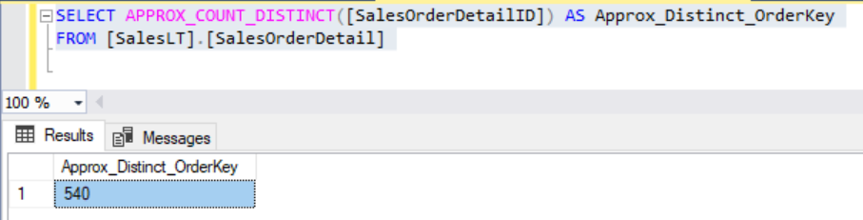
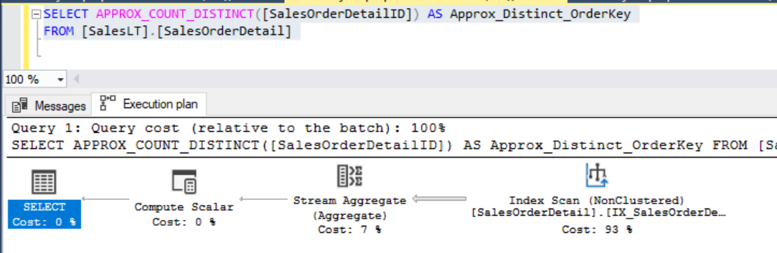
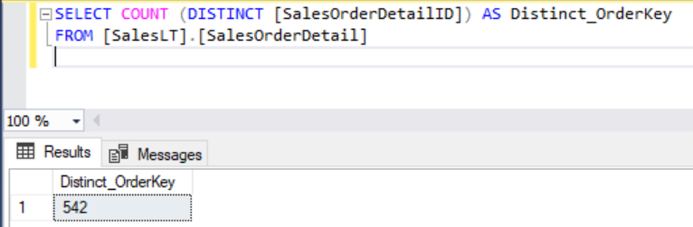
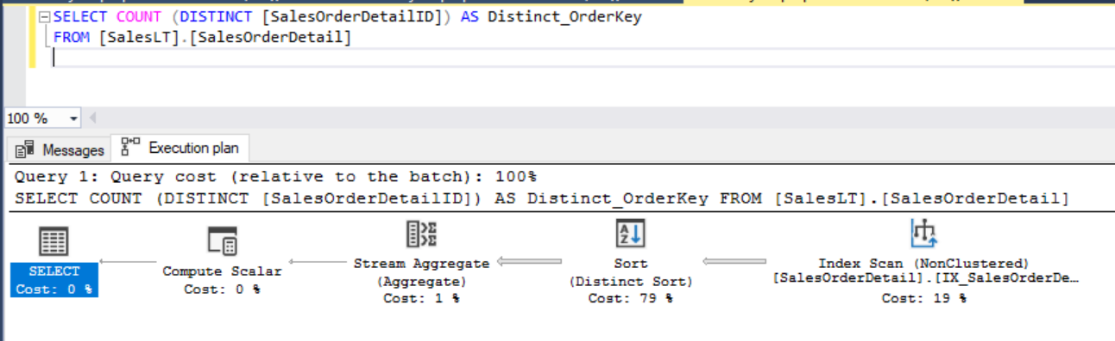
Approximate execution
APPROX_COUNT_DISTINCT
COUNT DISTINCT
Notes:
Query Execution Time

Slide 22
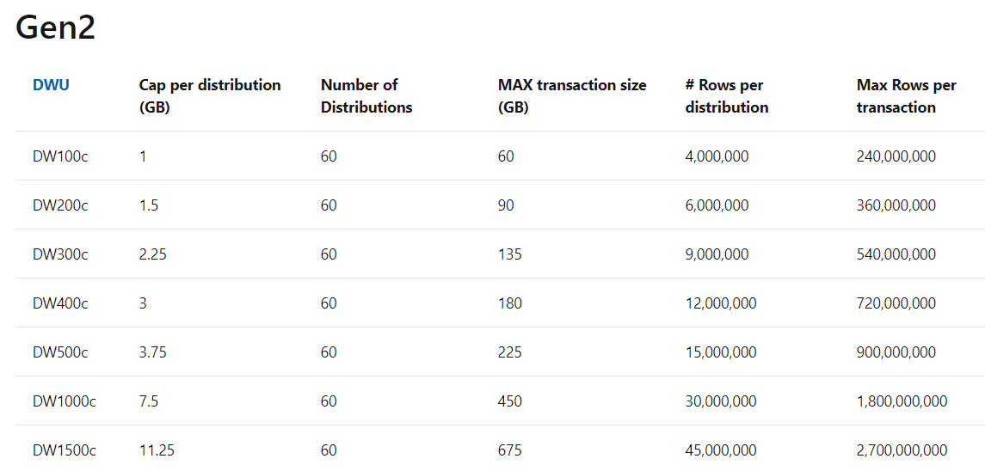
Transactions
ALTER DATABASE MyDatabase
SET ALLOW_SNAPSHOT_ISOLATION ON
ALTER DATABASE MyDatabase SET READ_COMMITTED_SNAPSHOT ON
Overview
Default level is READ UNCOMMITTED
Can switch to READ COMMITTED SNAPSHOT ISOLATION
Size limits
Limits are applied per distribution
The maximum transaction size depends on the spread of data across distributions
State management
XACT_STATE() behaves differently than in SQL Server
Uses -2 to mark failed transaction (SQL Server uses -1)
Once in -2 state, no further statements are allowed until roll back (SQL Server still permits reads)
Limitations
No distributed transactions, no nesting, no save points, no DDL
Assumes even distribution of data and average row length of 250 bytes
Notes:
SQL pool implements ACID transactions. The isolation level of the transactional support is default to READ UNCOMMITTED. You can change it to READ COMMITTED SNAPSHOT ISOLATION by turning ON the READ_COMMITTED_SNAPSHOT database option for a user database when connected to the master database.
Once enabled, all transactions in this database are executed under READ COMMITTED SNAPSHOT ISOLATION and setting READ UNCOMMITTED on session level will not be honored.
READ_COMMITTED_SNAPSHOT
OFF (Default) – Uses shared locks to prevent other transactions from modifying rows while running a read operation
ON – Uses row versioning to present each statement with a transactionally consistent snapshot of the data as it existed at the start of the statement. Locks are not used to protect the data from updates.
The maximum transaction size can only be achieved for HASH or ROUND_ROBIN distributed tables where the spread of the data is even. If the transaction is writing data in a skewed fashion to the distributions then the limit is likely to be reached prior to the maximum transaction size.
The use of -2 by the XACT_STATE function to denote a failed transaction represents different behavior to SQL Server. SQL Server uses the value -1 to represent an uncommittable transaction. SQL Server can tolerate some errors inside a transaction without it having to be marked as uncommittable. For example SELECT 1/0 would cause an error but not force a transaction into an uncommittable state. SQL Server also permits reads in the uncommittable transaction. However, SQL pool does not let you do this. If an error occurs inside a SQL pool transaction it will automatically enter the -2 state and you will not be able to make any further select statements until the statement has been rolled back. It is therefore important to check that your application code to see if it uses XACT_STATE() as you may need to make code modifications.
https://docs.microsoft.com/en-us/azure/synapse-analytics/sql/develop-transactions?view=azure-sqldw-latest

Slide 23
JSON data support – insert JSON data
-- Create Table with column for JSON string
CREATE TABLE CustomerOrders
(
CustomerId BIGINT NOT NULL,
Country NVARCHAR(150) NOT NULL,
OrderDetails NVARCHAR(3000) NOT NULL –- NVARCHAR column for JSON
) WITH (DISTRIBUTION = ROUND_ROBIN)
-- Populate table with semi-structured data
INSERT INTO CustomerOrders
VALUES
( 101, -- CustomerId
'Bahrain', -- Country
N'[{ StoreId": "AW73565",
"Order": { "Number":"SO43659",
"Date":"2011-05-31T00:00:00"
},
"Item": { "Price":2024.40, "Quantity":1 }
}]’ -- OrderDetails
)
Overview
The JSON format enables representation of complex or hierarchical data structures in tables.
JSON data is stored using standard NVARCHAR table columns.
Benefits
Transform arrays of JSON objects into table format
Performance optimization using clustered columnstore indexes and memory optimized tables

Slide 24
JSON data support – read JSON data
Overview
Read JSON data stored in a string column with the following:
ISJSON – verify if text is valid JSON
JSON_VALUE – extract a scalar value from a JSON string
JSON_QUERY – extract a JSON object or array from a JSON string
Benefits
Ability to get standard columns as well as JSON column
Perform aggregation and filter on JSON values
-- Return all rows with valid JSON data
SELECT CustomerId, OrderDetails
FROM CustomerOrders
WHERE ISJSON(OrderDetails) > 0;
CustomerId | OrderDetails
101 | N'[{ StoreId": "AW73565", "Order": { "Number":"SO43659", "Date":"2011-05-31T00:00:00“ }, "Item": { "Price":2024.40, "Quantity":1 }}]'
-- Extract values from JSON string
SELECT CustomerId,
Country,
JSON_VALUE(OrderDetails,'$.StoreId') AS StoreId,
JSON_QUERY(OrderDetails,'$.Item') AS ItemDetails
FROM CustomerOrders;
CustomerId | Country | StoreId | ItemDetails
101 | Bahrain | AW73565 | { "Price":2024.40, "Quantity":1 }

Slide 25
JSON data support – modify and operate on JSON data
Overview
Use standard table columns and values from JSON text in the same analytical query.
Modify JSON data with the following:
JSON_MODIFY – modifies a value in a JSON string
OPENJSON – convert JSON collection to a set of rows and columns
Benefits
Flexibility to update JSON string using T-SQL
Convert hierarchical data into flat tabular structure
-- Modify Item Quantity value
UPDATE CustomerOrders SET OrderDetails =
JSON_MODIFY(OrderDetails, '$.OrderDetails.Item.Quantity',2)
OrderDetails
N'[{ StoreId": "AW73565", "Order": { "Number":"SO43659", "Date":"2011-05-31T00:00:00“ }, "Item": { "Price":2024.40, "Quantity": 2}}]'
-- Convert JSON collection to rows and columns
SELECT CustomerId,
StoreId,
OrderDetails.OrderDate,
OrderDetails.OrderPrice
FROM CustomerOrders
CROSS APPLY OPENJSON (CustomerOrders.OrderDetails)
WITH ( StoreId VARCHAR(50) '$.StoreId',
OrderNumber VARCHAR(100) '$.Order.Date',
OrderDate DATETIME '$.Order.Date',
OrderPrice DECIMAL ‘$.Item.Price',
OrderQuantity INT '$.Item.Quantity'
) AS OrderDetails
CustomerId | StoreId | OrderDate | OrderPrice
101 | AW73565 | 2011-05-31T00:00:00 | 2024.40

Slide 26
Stored Procedures
CREATE PROCEDURE HumanResources.uspGetAllEmployees
AS
SET NOCOUNT ON;
SELECT LastName, FirstName, JobTitle, Department
FROM HumanResources.vEmployeeDepartment;
GO
-- Execute a stored procedures
EXECUTE HumanResources.uspGetAllEmployees;
GO
-- Or
EXEC HumanResources.uspGetAllEmployees;
GO
-- Or, if this procedure is the first statement within a batch:
HumanResources.uspGetAllEmployees;
Overview
No pre-compiled code
Think of SPs as containers for SQL logic
Limitations
Maximum 8 nesting levels (compared to 32 in SQL Server)
No support for @@NESTLEVEL
Cannot consume the result set of a stored procedure with INSERT
No CLR, no encryption, no replication, to table-valued parameters, no execution contexts, no return statement
Notes:
What to expect
SQL Data Warehouse supports many of the T-SQL features that are used in SQL Server. More importantly, there are scale-out specific features that you can use to maximize the performance of your solution.
However, to maintain the scale and performance of SQL Data Warehouse there are also some features and functionality that have behavioral differences and others that are not supported.
Introducing stored procedures
Stored procedures are a great way for encapsulating your SQL code; storing it close to your data in the data warehouse. Stored procedures help developers modularize their solutions by encapsulating the code into manageable units; facilitating greater reusability of code. Each stored procedure can also accept parameters to make them even more flexible.
SQL Data Warehouse provides a simplified and streamlined stored procedure implementation. The biggest difference compared to SQL Server is that the stored procedure is not pre-compiled code. In data warehouses, the compilation time is small in comparison to the time it takes to run queries against large data volumes. It is more important to ensure the stored procedure code is correctly optimized for large queries. The goal is to save hours, minutes, and seconds, not milliseconds. It is therefore more helpful to think of stored procedures as containers for SQL logic.
When SQL Data Warehouse executes your stored procedure, the SQL statements are parsed, translated, and optimized at run time. During this process, each statement is converted into distributed queries. The SQL code that is executed against the data is different than the query submitted.
Source: https://docs.microsoft.com/en-us/azure/sql-data-warehouse/sql-data-warehouse-develop-stored-procedures

Slide 27









Synapse SQL - clients and tools
Tools
Web IDE - Synapse Studio
Client tools - Azure Data Studio, SSMS,
Any tool/library that uses standard SQL can access serverless SQL pool
PowerBI
Azure Analytic Services
Client languages and drivers that works with Azure SQL can be used to access serverless SQL pool

Slide 28
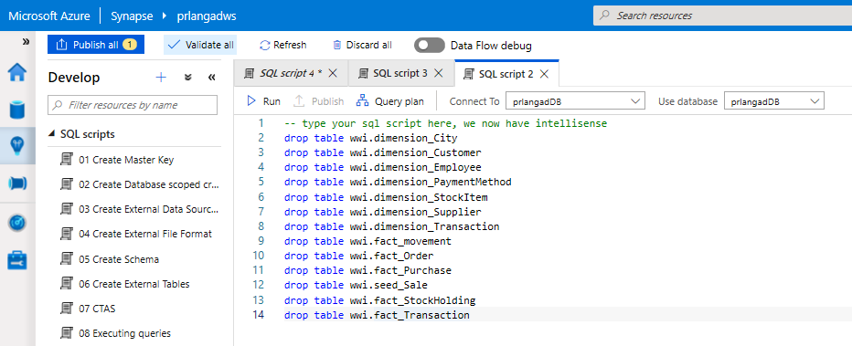
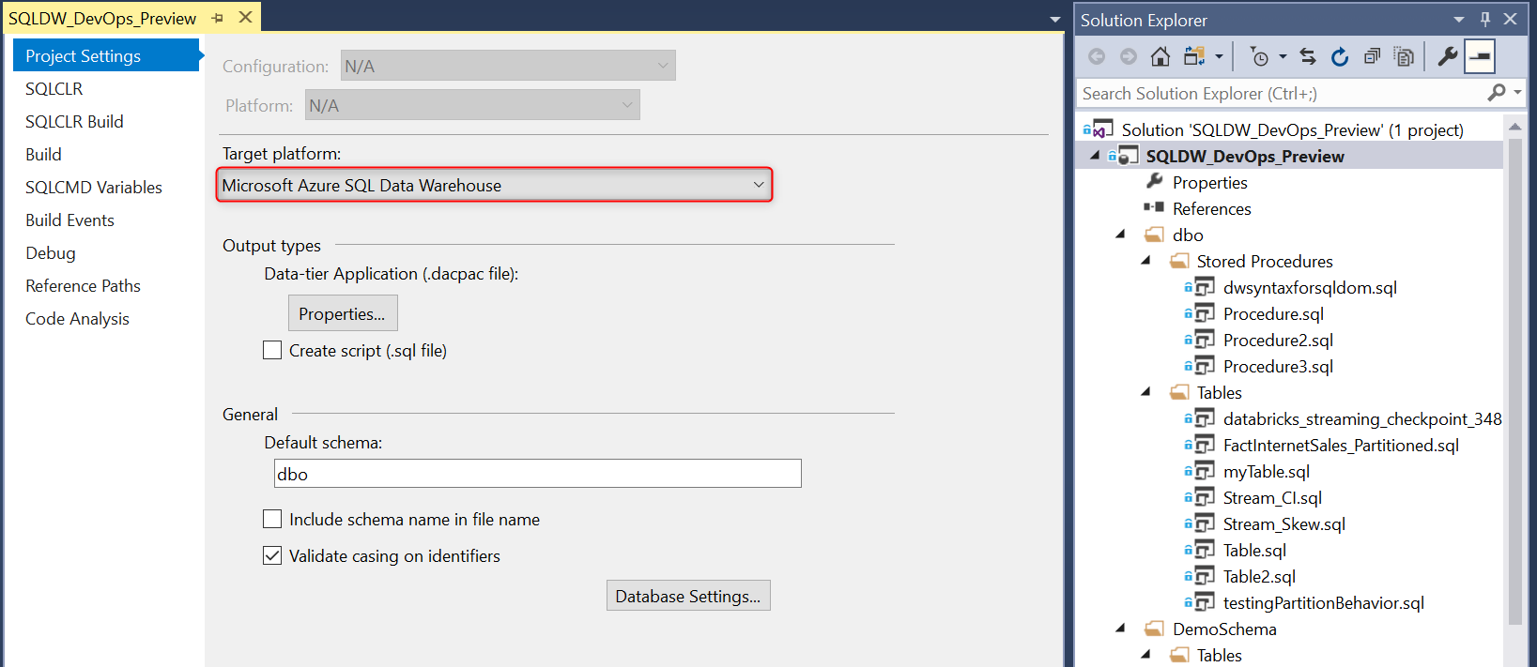
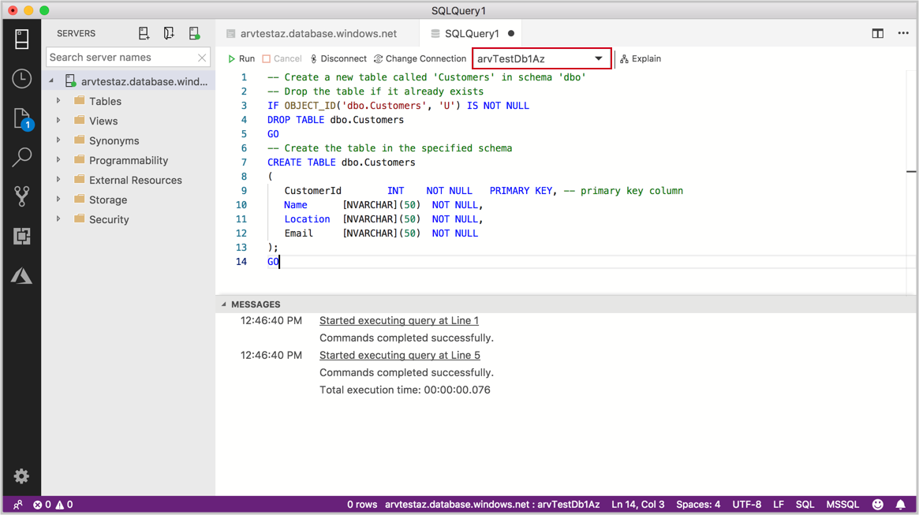
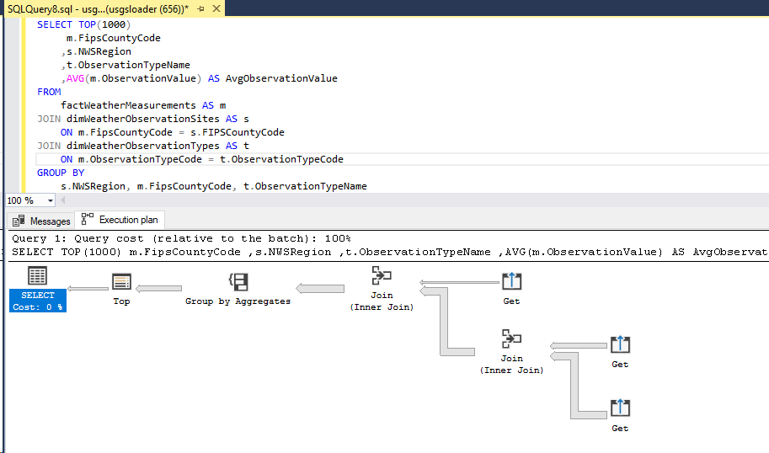
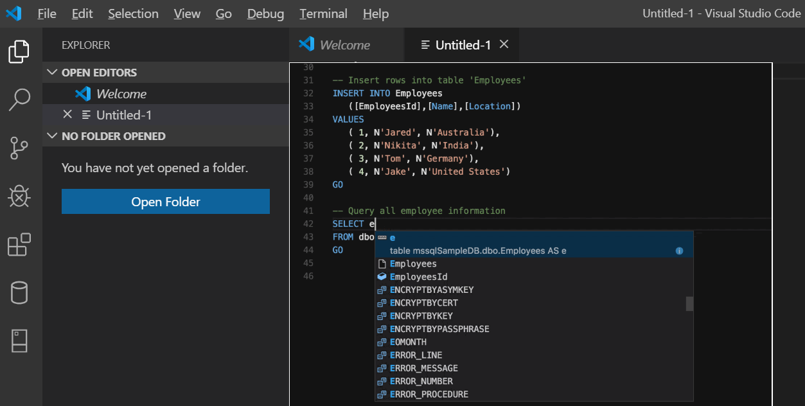
Developer Tools
Azure Synapse Analytics
Visual Studio - SSDT database projects
Azure Data Studio (queries, extensions etc.)
SQL Server Management Studio
(queries, execution plans etc.)
Visual Studio Code
Notes:
https://docs.microsoft.com/en-us/sql/tools/overview-sql-tools?view=sql-server-2017
https://azure.microsoft.com/en-us/blog/seamless-access-to-management-insights-for-sql-data-warehouse-with-data-studio/

Slide 29
Pop Quiz
What reduction in accuracy does APPROXIMATE_COUNT_DISTINCT (HyperLogLog) show on average?
A)
2%
B)
0.1%
C)
0.5%

Slide 30
Pop Quiz
What reduction in accuracy does APPROXIMATE_COUNT_DISTINCT (HyperLogLog) show on average?
A)
2%
B)
0.1%
C)
0.5%

Slide 31
SQL Recap
Query JSON using Azure Synapse SQL in conjunction with T-SQL OPENJSON, JSON_VALUE, and JSON_Query statements.
Modify JSON data during UPDATE using the JSON_MODIFY statement.
Use APPROXIMATE_COUNT_DISTINCT for better count query performance- results within average 2% accuracy of the true count.
Notes:
Some of their data contains columns in the JSON format, how could they flatten these hierarchical fields to a tabular structure?
They can use Azure Synapse SQL serverless along with the T-SQL OPENJSON, JSON_VALUE, and JSON_QUERY statements.
What approach can they use to update the JSON data?
They can use JSON_MODIFY with the UPDATE statement.
In some of their queries, they are OK trading off speed of returning counts for a small reduction in accuracy. How might they do this?
They should use the APPROXIMATE_COUNT_DISTINCT statement which uses the HyperLogLog to return a result with an average 2% accuracy of the true cardinality. For example, if COUNT(DISTINCT) returns 1,000,000, then with approximate execution you will get a value between 999,736 to 1,016,234.

Slide 32
Performance Patterns

Slide 33
Distributed table design recommendations
Hash Distribution:
Large fact tables exceeding several GBs with frequent inserts should use a hash distribution.
Round Robin Distribution:
Potentially useful tables created from raw input.
Temporary staging tables used in data preparation.
Replicated Tables:
Lookup tables that range in size from 100’s MBs to 1.5 GBs should be replicated. Works best when table size is less than 2 GB compressed.
Notes:
What are the typical issues they should look out for with regards to distributed table design for the following scenarios?
Their smallest fact table exceeds several GB’s and by their nature experiences frequent inserts.
They should use a hash distribution.
A hash-distributed table distributes table rows across the Compute nodes by using a deterministic hash function to assign each row to one distribution.
Since identical values always hash to the same distribution, the data warehouse has built-in knowledge of the row locations. SQL Data Warehouse uses this knowledge to minimize data movement during queries, which improves query performance.
Hash-distributed tables work well for large fact tables in a star schema. They can have very large numbers of rows and still achieve high performance.
Consider using a hash-distributed table when:
The table size on disk is more than 2 GB.
The table has frequent insert, update, and delete operations.
As they develop the data warehouse, the WWI data team identified some tables created from the raw input that might be useful, but they don’t currently join to other tables and they are not sure of the best columns they should use for distributing the data.
They should consider round-robin distribution.
A round-robin distributed table distributes table rows evenly across all distributions. The assignment of rows to distributions is random. Unlike hash-distributed tables, rows with equal values are not guaranteed to be assigned to the same distribution.
As a result, the system sometimes needs to invoke a data movement operation to better organize your data before it can resolve a query. This extra step can slow down your queries. For example, joining a round-robin table usually requires reshuffling the rows, which is a performance hit.
Consider using the round-robin distribution for your table in the following scenarios:
When getting started as a simple starting point since it is the default
If there is no obvious joining key
If there is not good candidate column for hash distributing the table
If the table does not share a common join key with other tables
If the join is less significant than other joins in the query
When the table is a temporary staging table
Their data engineers sometimes use temporary staging tables in their data preparation.
They should use a round-robin distributed table.
They have lookup tables that range from several hundred MBs to 1.5 GBs.
They should consider using replicated tables.
A replicated table has a full copy of the table accessible on each Compute node. Replicating a table removes the need to transfer data among Compute nodes before a join or aggregation. Since the table has multiple copies, replicated tables work best when the table size is less than 2 GB compressed.

Slide 34
Automatic statistics management
-- Turn on/off auto-create statistics settings
ALTER DATABASE {database_name}
SET AUTO_CREATE_STATISTICS { ON | OFF }
-- Turn on/off auto-update statistics settings
ALTER DATABASE {database_name}
SET AUTO_UPDATE_STATISTICS { ON | OFF }
-- Configure synchronous/asynchronous update
ALTER DATABASE {database_name}
SET AUTO_UPDATE_STATISTICS_ASYNC { ON | OFF }
-- Check statistics settings for a database
SELECT is_auto_create_stats_on,
is_auto_update_stats_on,
is_auto_update_stats_async_on
FROM sys.databases
Overview
Statistics are automatically created and maintained for SQL pool. Incoming queries are analyzed, and individual column statistics are generated on the columns that improve cardinality estimates to enhance query performance.
Statistics are automatically updated as data modifications occur in underlying tables. By default, these updates are synchronous but can be configured to be asynchronous.
Statistics are considered out of date when:
There was a data change on an empty table
The number of rows in the table at time of statistics creation was 500 or less, and more than 500 rows have been updated
The number of rows in the table at time of statistics creation was more than 500, and more than 500 + 20% of rows have been updated
Notes:
By default, auto update statistics are configured to be synchronous but can be configured to be asynchronous operations
Statistics are updated opportunistically when queries are run.

Slide 35
Performance Anti-Patterns

Slide 36
Too many partitions
Partitions can be useful when maintaining current rows in very large fact tables. Partition switching is a good alternative to full CTAS
Partitioning CCIs is only useful when the row count is greater than 60million * #partitions
In general, avoid partitions, particularly in POCs

Slide 37
Views on Views
Views on Views will not support performance optimization using Materialized Views (more later)
Views cannot be distributed

Slide 38
Thank You slide
Thank you

Slide 39

Break
Please take this time for a short 15 minute break
Relax and come back refreshed for our next activity
If at anytime you require assistance please send a message to the “Need help – ask here” channel in the Microsoft Teams site for this event

Slide 40

Hands-On Build Activity: Data Warehouse Optimization Part 1
Objective: As a result of participating in this lab, you will be better able to optimize Data Warehouse query performance within deployed Azure Synapse Analytics solutions
What you will be doing: This will be a chance for you to work individually in your lab environment to complete a set of tasks you would typically follow in work associated with optimizing your customer’s data after you have completed your data ingestion. A set of tasks are outlined for you to follow and complete.
Total Activity Time: 60 minutes

Slide 41









Lab: individual lab exercise
GUIDE:
Activity 03: Data Warehouse Optimization
https://github.com/solliancenet/data-ai-technical-bootcamp/
Step 1: Go to your table group channel
Step 2: Your Learning Adviser will provide you a unique cloud lab login link
Step 3: Login and begin the lab. Engage your table group via a Microsoft Teams “meet now” call to support each other (meet now button in upper right corner of application)

Slide 42


Objective: As a result of attending this, attendees will better be able to implement optimization strategizes for the data warehouse using SQL based approached in Azure Synapse Analytics.
Breakout Activity: Data Warehouse Optimization
What you will be doing: Within your breakout group in Teams, you will collaborate with your peers to review challenges and decide on how to address them. Working within a shared labs environment (one lab environment per cohort), you will complete the challenges using Azure Synapse Analytics Studio. The challenges cover table and index configuration and query performance optimization.
Total Activity Time: 30 minutes

Slide 43
Activity: group-based lab exercise
Step 1: Go to your table group channel
Step 2: Your Learning Adviser will provide you a unique cloud lab login link
Step 3: Login and begin the lab. Engage your table group via a Microsoft Teams “meet now” call to collaborate with each other (meet now button in upper right corner of application)

Slide 44
DW Optimization Part 2

Slide 45


Question…
How many indexing methods are there for a Synapse table?
Can you name them all?
Notes:
Clustered Columnstore, Clustered index (and non-clustered index), Heap

Slide 46
Agenda
1 Performance Patterns
Result set caching and materialized views.
2 Index design
Clustered columnstore index and ordered variant, clustered index, heap and non-clustered index.
3 Perf Anti-Patterns
Approaches the impede or limit performance.

Slide 47
Performance Patterns

Slide 48
Result set caching motivated
Use result-set caching to improve query performance when the same queries are executed repeatedly against mainly static data.
Result-set cache is invalidated and refreshed when underlying table data changes or the query code changes
Result-set cache persists when SQL Pool is paused and resumed.
Notes:
Their downstream reports are used by many users, which often means the same query is being executed repeatedly against data that does not change that often. What can WWI to improve the performance of these types of queries? How does this approach work when the underlying data changes?
They should consider result-set caching.
Cache the results of a query in provisioned Azure Synapse SQL Pool storage. This enables interactive response times for repetitive queries against tables with infrequent data changes.
The result-set cache persists even if SQL pool is paused and resumed later.
Query cache is invalidated and refreshed when underlying table data or query code changes.
Result cache is evicted regularly based on a time-aware least recently used algorithm (TLRU).

Slide 49
Result-set caching
Overview
Cache the results of a query in SQL pool storage. This enables interactive response times for repetitive queries against tables with infrequent data changes.
The result-set cache persists even if SQL pool is paused and resumed later.
Query cache is invalidated and refreshed when underlying table data or query code changes.
Result cache is evicted regularly based on a time-aware least recently used algorithm (TLRU).
Benefits
Enhances performance when same result is requested repetitively
Reduced load on server for repeated queries
Offers monitoring of query execution with a result cache hit or miss
-- Turn on/off result-set caching for a database
-- Must be run on the MASTER database
ALTER DATABASE {database_name}
SET RESULT_SET_CACHING { ON | OFF }
-- Turn on/off result-set caching for a client session
-- Run on target Azure Synapse Analytics
SET RESULT_SET_CACHING {ON | OFF}
-- Check result-set caching setting for a database
-- Run on target Azure Synapse Analytics
SELECT is_result_set_caching_on
FROM sys.databases
WHERE name = {database_name}
-- Return all query requests with cache hits
-- Run on target data warehouse
SELECT *
FROM sys.dm_pdw_request_steps
WHERE command like '%DWResultCacheDb%'
AND step_index = 0
Notes:
Result-set caching
The maximum size of the result-set cache is 1TB
Query results are persisted for a maximum of 48 hours but can be evicted earlier to save space based on the least recently used result
Disabled on DW by default unless turned on at a session level or the entire database level
Additional storage costs are incurred by caching query result sets
Check the is_result_set_caching column in the sys.databases DMV to show the result-set caching setting for a database
Users can tell if a query was executed with a result cache hit or miss by querying sys.pdw_request_steps for commands where value is like ‘%DWResultCacheDb%’

Slide 50



Result-set caching flow
01010100010100101010
01010100010100101010
1
Client sends query to SQL pool
2
Query is processed using compute nodes which pull data from remote storage, process query and output back to client app
Query results are cached in remote storage so subsequent requests can be served immediately
01010100010100101010
3
Subsequent executions for the same query bypass compute nodes and can be fetched instantly from persistent cache in remote storage
4
Remote storage cache is evicted regularly based on time, cache usage, and any modifications to underlying table data.
5
Cache will need to be regenerated if query results have been evicted from cache
Notes:
Result-set caching
The maximum size of the result-set cache is 1TB
Query results are persisted for a maximum of 48 hours but can be evicted earlier to save space based on the least recently used result
Disabled on DW by default unless turned on at a session level or the entire database level
Additional storage costs are incurred by caching query result sets
Check the is_result_set_caching column in the sys.databases DMV to show the result-set caching setting for a database
Users can tell if a query was executed with a result cache hit or miss by querying sys.pdw_request_steps for commands where value is like ‘%DWResultCacheDb%’

Slide 51
Materialized views
-- Create indexed view
CREATE MATERIALIZED VIEW Sales.vw_Orders
WITH
(
DISTRIBUTION = ROUND_ROBIN |
HASH(ProductID)
)
AS
SELECT SUM(UnitPrice*OrderQty) AS Revenue,
OrderDate,
ProductID,
COUNT_BIG(*) AS OrderCount
FROM Sales.SalesOrderDetail
GROUP BY OrderDate, ProductID;
GO
-- Disable index view and put it in suspended mode
ALTER INDEX ALL ON Sales.vw_Orders DISABLE;
-- Re-enable index view by rebuilding it
ALTER INDEX ALL ON Sales.vw_Orders REBUILD;
Overview
A materialized view pre-computes, stores, and maintains its data like a table.
Materialized views are automatically updated when data in underlying tables are changed. This is a synchronous operation that occurs as soon as the data is changed.
The auto caching functionality allows Azure Synapse Analytics Query Optimizer to consider using indexed view even if the view is not referenced in the query.
Supported aggregations: MAX, MIN, AVG, COUNT, COUNT_BIG, SUM, VAR, STDEV
Benefits
Automatic and synchronous data refresh with data changes in base tables. No user action is required.
High availability and resiliency as regular tables
Notes:
Current Limitations:
If MIN/MAX aggregates are used in the SELECT list, the indexed view will automatically be disabled when UPDATE and DELETE occur in the referenced base tables. Run ALTER INDEX with REBUILD to re-enable the indexed view
Only INNER JOIN is supported
Only HASH and ROUND_ROBIN distributions are supported
Only CLUSTERED COLUMNSTORE INDEX is supported
ALTER VIEW is not supported

Slide 52
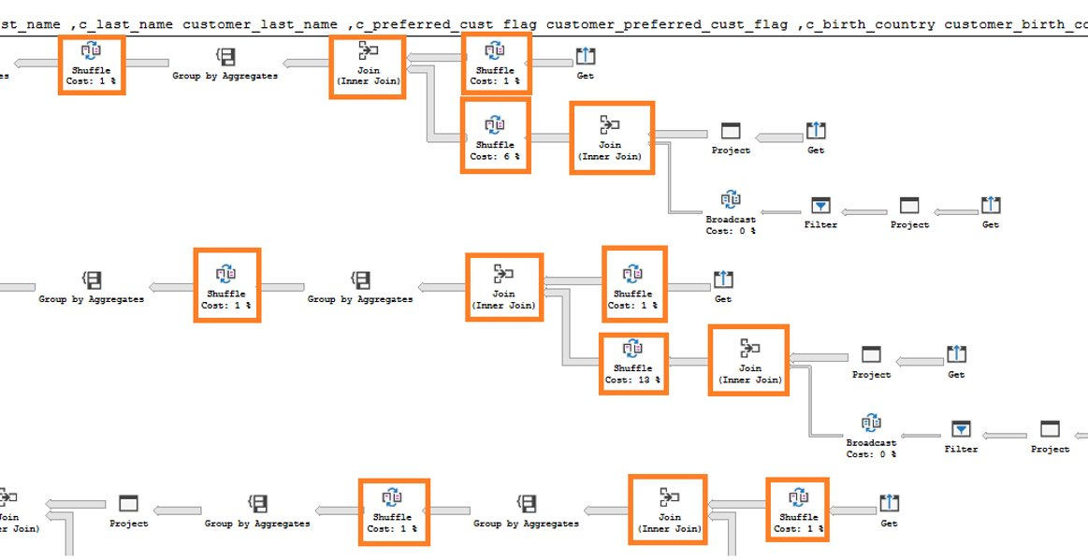
Materialized views - example
In this example, a query to get the year total sales per customer is shown to have a lot of data shuffles and joins that contribute to slow performance:
No relevant indexed views created on the data warehouse
Execution time: 103 seconds Lots of data shuffles and joins needed to complete query
-- Get year total sales per customer
(WITH year_total AS
SELECT customer_id,​
first_name,​
last_name,
birth_country, login,
email_address​,
d_year,
SUM(ISNULL(list_price – wholesale_cost – discount_amt + sales_price, 0)/2)year_total​
FROM customer cust
JOIN catalog_sales sales ON cust.sk = sales.sk
JOIN date_dim ON sales.sold_date = date_dim.date
GROUP BY customer_id​, first_name​, last_name​,birth_country​, login​,email_address​ ,d_year​
)
SELECT TOP 100 …
FROM year_total …
WHERE …
ORDER BY …

Slide 53
Indexed Materialized views - example
Now, we add an indexed view to the data warehouse to increase the performance of the previous query. This view can be leveraged by the query even though it is not directly referenced.
Original query – get year total sales per customer
Create indexed view with hash distribution on customer_id column
-- Get year total sales per customer
(WITH year_total AS
SELECT customer_id,​
first_name,​
last_name,
birth_country, login,
email_address​,
d_year,
SUM(ISNULL(list_price – wholesale_cost – discount_amt + sales_price, 0)/2)year_total​
FROM customer cust
JOIN catalog_sales sales ON cust.sk = sales.sk
JOIN date_dim ON sales.sold_date = date_dim.date
GROUP BY customer_id​, first_name​, last_name​,birth_country​, login​,email_address​ ,d_year​
)
SELECT TOP 100 …
FROM year_total …
WHERE …
ORDER BY …
-- Create indexed view for query
CREATE INDEXED VIEW nbViewCS WITH (DISTRIBUTION=HASH(customer_id)) AS
SELECT customer_id,​
first_name,​
last_name,
birth_country, login,
email_address​,
d_year,
SUM(ISNULL(list_price – wholesale_cost – discount_amt +
sales_price, 0)/2) AS year_total​
FROM customer cust
JOIN catalog_sales sales ON cust.sk = sales.sk
JOIN date_dim ON sales.sold_date = date_dim.date
GROUP BY customer_id​, first_name​,
last_name​,birth_country​,
login​, email_address​, d_year​

Slide 54
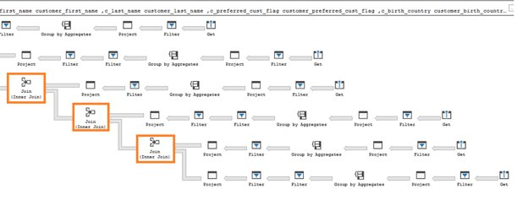
Indexed (materialized) views - example
SQL pool query optimizer automatically leverages the indexed view to speed up the same query. Notice that the query does not need to reference the view directly
Execution time: 6 seconds Optimizer leverages materialized view to reduce data shuffles and joins needed
Original query – no changes have been made to query
-- Get year total sales per customer
(WITH year_total AS
SELECT customer_id,​
first_name,​
last_name,
birth_country, login,
email_address​,
d_year,
SUM(ISNULL(list_price – wholesale_cost – discount_amt + sales_price, 0)/2)year_total​
FROM customer cust
JOIN catalog_sales sales ON cust.sk = sales.sk
JOIN date_dim ON sales.sold_date = date_dim.date
GROUP BY customer_id​, first_name​, last_name​,birth_country​, login​,email_address​ ,d_year​
)
SELECT TOP 100 …
FROM year_total …
WHERE …
ORDER BY …

Slide 55
Materialized views- Recommendations
EXPLAIN - provides query plan for SQL statement without running the statement; view estimated cost of the query operations.
EXPLAIN WITH_RECOMMENDATIONS - provides query plan with recommendations to optimize the SQL statement performance.
EXPLAIN WITH_RECOMMENDATIONS
select count(*)
from (
(select distinct c_last_name, c_first_name, d_date
from store_sales, date_dim, customer
where store_sales.ss_sold_date_sk = date_dim.d_date_sk
and store_sales.ss_customer_sk = customer.c_customer_sk
and d_month_seq between 1194 and 1194+11)
except
(select distinct c_last_name, c_first_name, d_date
from catalog_sales, date_dim, customer
where catalog_sales.cs_sold_date_sk = date_dim.d_date_sk
and catalog_sales.cs_bill_customer_sk = customer.c_customer_sk and d_month_seq between 1194 and 1194+11)
) top_customers

Slide 56
Indexed Materialized Views
Indexed views cache the schema and data for a view in DW remote storage. They are useful for improving the performance of ‘SELECT’ statement queries that include aggregations
Indexed views are automatically updated when data in underlying tables are changed. This is a synchronous operation that occurs as soon as the data is changed.
The auto caching functionality allows Synapse Query Optimizer to consider using indexed view even if the view is not referenced in the query
Supported aggregations: MAX, MIN, AVG, COUNT, COUNT_BIG, SUM, VAR, STDEV

Slide 57
Index design

Slide 58
Tables – Indexes
Clustered Columnstore index (Default Primary)
Highest level of data compression
Best overall query performance
Clustered index (Primary)
Performant for looking up a single to few rows
Heap (Primary)
Faster loading and landing temporary data
Best for small lookup tables
Nonclustered indexes (Secondary)
Enable ordering of multiple columns in a table
Allows multiple nonclustered on a single table
Can be created on any of the above primary indexes
More performant lookup queries
-- Create table with index
CREATE TABLE orderTable
(
OrderId INT NOT NULL,
Date DATE NOT NULL,
Name VARCHAR(2),
Country VARCHAR(2)
)
WITH
(
CLUSTERED COLUMNSTORE INDEX |
HEAP |
CLUSTERED INDEX (OrderId)
);
-- Add non-clustered index to table
CREATE INDEX NameIndex ON orderTable (Name);
Notes:
Clustered columnstore indexes
By default, SQL Data Warehouse creates a clustered columnstore index when no index options are specified on a table. Clustered columnstore tables offer both the highest level of data compression as well as the best overall query performance. Clustered columnstore tables will generally outperform clustered index or heap tables and are usually the best choice for large tables. For these reasons, clustered columnstore is the best place to start when you are unsure of how to index your table.
There are a few scenarios where clustered columnstore may not be a good option:
Columnstore tables do not support varchar(max), nvarchar(max) and varbinary(max). Consider heap or clustered index instead.
Columnstore tables may be less efficient for transient data. Consider heap and perhaps even temporary tables.
Small tables with less than 100 million rows. Consider heap tables.
Clustered and nonclustered indexes
Clustered indexes may outperform clustered columnstore tables when a single row needs to be quickly retrieved. For queries where a single or very few row lookup is required to performance with extreme speed, consider a cluster index or nonclustered secondary index. The disadvantage to using a clustered index is that only queries that benefit are the ones that use a highly selective filter on the clustered index column. To improve filter on other columns a nonclustered index can be added to other columns. However, each index which is added to a table adds both space and processing time to loads.
Heap tables
When you are temporarily landing data on SQL Data Warehouse, you may find that using a heap table makes the overall process faster. This is because loads to heaps are faster than to index tables and in some cases the subsequent read can be done from cache. If you are loading data only to stage it before running more transformations, loading the table to heap table is much faster than loading the data to a clustered columnstore table. In addition, loading data to a temporary table loads faster than loading a table to permanent storage.
For small lookup tables, less than 100 million rows, often heap tables make sense. Cluster columnstore tables begin to achieve optimal compression once there is more than 100 million rows.
Source: https://docs.microsoft.com/en-us/azure/sql-data-warehouse/sql-data-warehouse-tables-index

Slide 59
SQL Analytics Columnstore Tables
Logical table structure
Clustered columnstore index (OrderId)
Clustered/Non-clustered rowstore index (OrderId)
OrderId | Date | Name | Country
85016 | 11-2-2018 | V | UK
85018 | 11-2-2018 | Q | SP
85216 | 11-2-2018 | Q | DE
85395 | 11-2-2018 | V | NL
82147 | 11-2-2018 | Q | FR
86881 | 11-2-2018 | D | UK
93080 | 11-3-2018 | R | UK
94156 | 11-3-2018 | S | FR
96250 | 11-3-2018 | Q | NL
98799 | 11-3-2018 | R | NL
98015 | 11-3-2018 | T | UK
98310 | 11-3-2018 | D | DE
98979 | 11-3-2018 | Z | DE
98137 | 11-3-2018 | T | FR
… | … | … | …
OrderId | PageId
82147 | 1001
98137 | 1002
Rowgroup1 Min (OrderId): 82147 | Max (OrderId): 85395
OrderId
82147
85016
85018
85216
85395
Country
FR
UK
SP
DE
NL
OrderId | PageId
82147 | 1005
85395 | 1006
OrderId | PageId
98137 | 1007
98979 | 1008
…
Name
Q
V
…
…
Date
11-2-2018
OrderId | Date | Name | Country
82147 | 11-2-2018 | Q | FR
85016 | 11-2-2018 | V | UK
85018 | 11-2-2018 | Q | SP
OrderId | Date | Name | Country
98137 | 11-3-2018 | T | FR
98310 | 11-3-2018 | D | DE
98799 | 11-3-2018 | R | NL
OrderId | Date | Name | Country
82147 | 11-2-2018 | Q | FR
85016 | 11-2-2018 | V | UK
85018 | 11-2-2018 | Q | SP
OrderId | Date | Name | Country
98137 | 11-3-2018 | T | FR
98310 | 11-3-2018 | D | DE
98799 | 11-3-2018 | R | NL
+
Delta Rowstore
OrderId | Date | Name | Country
98137 | 11-3-2018 | T | FR
98310 | 11-3-2018 | D | DE
98799 | 11-3-2018 | R | NL
98979 | 11-3-2018 | Z | DE
Data is stored in a B-tree index structure for performant lookup queries for particular rows.
Clustered rowstore index: The leaf nodes in the structure store the data values in a row (as pictured above)
Non-clustered (secondary) rowstore index: The leaf nodes store pointers to the data values, not the values themselves
Data stored in compressed columnstore segments after being sliced into groups of rows (rowgroups/micro-partitions) for maximum compression
Rows are stored in the delta rowstore until the number of rows is large enough to be compressed into a columnstore
Notes:
Format slide

Slide 60
Ordered Clustered Columnstore Indexes
The problem with CCI
The index builder doesn’t sort data before compressing it into segments, which means that segments with overlapping value ranges could occur.
When this happens, queries might read more segments from disk and take longer to finish.
The solution
Ordered CCIs – data is sorted in memory by the order key(s) before the index builder compresses the segments and thus segment overlapping is reduced.
-- Create Table with Ordered Columnstore Index
CREATE TABLE sortedOrderTable
(
OrderId INT NOT NULL,
Date DATE NOT NULL,
Name VARCHAR(2),
Country VARCHAR(2)
)
WITH
(
CLUSTERED COLUMNSTORE INDEX ORDER (OrderId)
)
-- Create Clustered Columnstore Index on existing table
CREATE CLUSTERED COLUMNSTORE INDEX cciOrderId
ON dbo.OrderTable ORDER (OrderId)
-- Insert data into table with ordered columnstore index
INSERT INTO sortedOrderTable
VALUES (1, '01-01-2019','Dave’, 'UK')
Notes:
Formatting

Slide 61
Ordered CCI
Queries against tables with ordered columnstore segments can take advantage of improved segment elimination to drastically reduce the time needed to service a query.
Columnstore Segments are automatically updated as data is inserted, updated, or deleted in data warehouse tables.
New data resulting from the same batch of DML or data loading operations is sorted within that batch (no global sorting across all data in the table).
REBUILD can be used to sort all data in the table (which is an offline operation, done one partition at a time).

Slide 62
Ordered CCI - Performance
The number of overlapping segments depends on:
The size of data to sort
Available memory (use XLARGERC on a higher DWU to allow more memory for data sorting before compressing occurs)
MAXDOP (create ordered CCI with MAXDOP =1 as each thread used for ordered CCI works on a subset of data and sorts it locally)
Pre-sort the data by the sort key(s) before loading

Slide 63
Choosing the right index
Clustered Columnstore indexes (CCI) are best for fact tables.
CCI offer the highest level of data compression and best query performance for tables with over 100 million rows.
Heap tables are best for small lookup tables and recommended for tables with less than 100 million rows.
Clustered Indexes may outperform CCI when very few rows need to be retrieved quickly.
Add non-clustered indexes to improve performance for less selective queries.
Each additional index added to a table increases storage space required and processing time during data loads.
Speed load performance by staging data in heap tables and temporary tables prior to running transformations.
as
Notes:
Their sales transaction dataset exceeds a billion rows. For their downstream reporting queries, they need to be able to join, project and filter these rows in no longer than 10s of seconds. WWI is concerned their data is just too big to do this.
What specific indexing techniques should they use to reach this kind of performance for their fact tables? Why?
Clustered Columnstore Indexes. As they offer the highest level of data compression and best overall query performance, columnstore indexes are usually the best choice for large tables such as fact tables.
Would you recommend the same approach for tables they have with less than 100 million rows?
No. For "small" tables with less than 100 million rows, they should consider Heap tables.
How should they configure indexes on their smaller lookup tables (e.g., those that contain store names and addresses)?
They should consider using Heap tables. For small lookup tables, less than 100 million rows, often heap tables make sense. Cluster columnstore tables begin to achieve optimal compression once there is more than 100 million rows.
What would you suggest for their larger lookup tables that are used just for point lookups that retrieve only a single row? How could they makes these more flexible so that queries filtering against different sets of columns would still yield efficient lookups?
Use clustered indexes. Clustered indexes may outperform clustered columnstore tables when a single row needs to be quickly retrieved. For queries where a single or a very few number of rows to lookup is required to perform with extreme speed, consider a clustered index or non-clustered secondary index.
The disadvantage to using a clustered index is that the only queries that benefit are the ones that use a highly selective filter on the clustered index column. To improve filter performance on other columns, a non-clustered index can be added to other columns.
However, be aware that each index which is added to a table adds both space and processing time to data loads.
What should they use for the fastest loading of staging tables?
A heap table. If you are loading data only to stage it before running more transformations, loading the table to heap table is much faster than loading the data to a clustered columnstore table.
A temporary table. Loading data to a temporary table loads faster than loading a table to permanent storage.

Slide 64
Performance Anti-Patterns

Slide 65
Too many indexes
Start without indexes. The overhead of maintaining them can be greater than their value.
A primary-key non-clustered index may improve performance of joins when fact tables are joined to very large (billion+) dimensions

Slide 66




Pop Quiz
dbo.dimProduct
1.5k rows
Product information
CCI
dbo.Sales
150M rows
Single sales lookups
Heap
Match the tables with their recommended index!
dbo.LineItem
30B rows
Primary fact table
CI
stg.stagingLineItem
10k rows
Staging table for loads

Slide 67
Pop Quiz
dbo.dimProduct
1.5k rows
Product information
CCI
dbo.Sales
150M rows
Single sales lookups
Heap
Match the tables with their recommended index!
dbo.LineItem
30B rows
Primary fact table
CI
stg.stagingLineItem
10k rows
Staging table for loads

Slide 68









Modern Data Warehouse
INGEST
PREPARE
TRANSFORM & ENRICH
SERVE
VISUALIZE
AZURE SYNAPSE ANALYTICS
Synapse SQL (Dedicated)
Synapse Pipeline
Synapse SQL (Dedicated)
Data Sources
Synapse SQL (Serverless)
Synapse Pipeline
Power BI
OR
OR
Synapse Pipelines
Synapse SQL (Serverless)
Apache Spark
Apache Spark
Synapse SQL (Serverless)
STORE
ADLS Gen 2
Storage Account
Data Lake

Slide 69
Thank You slide
Thank you

Slide 70
Break
Please take this time for a short 15 minute break
Relax and come back refreshed for our next activity
If at anytime you require assistance please send a message to the “Need help – ask here” channel in the Microsoft Teams site for this event

Slide 71
Hands-On Build Activity: Data Warehouse Optimization Part 2
Objective: As a result of participating in this lab, you will be able to optimize the data warehouse table configuration and understand the impact on query performance
What you will be doing: Like the Part 1 exercise, you work individually in your lab environment to complete a set of tasks you would typically follow in work associated with optimizing your customer’s data after you have completed your data ingestion. A set of tasks are outlined for you to follow and complete.
Total Activity Time: 45 minutes

Slide 72
Lab: individual lab exercise
Step 1: Go to your table group channel
Step 2: Your Learning Adviser will provide you a unique cloud lab login link
Step 3: Login and begin the lab. Engage your table group via a Microsoft Teams “meet now” call to support each other (meet now button in upper right corner of application)

Slide 73

Break
Please take this time for a 1-hour break
But first, a thought exchange question
Now, take time to relax and come back refreshed for our next activity
If at anytime you require assistance please send a message to the “Need help – ask here” channel in the Microsoft Teams site for this event

Slide 74
Security in Azure Synapse

Slide 75
Agenda
1 Security baseline
Synapse Analytics security baseline
2 Network security
Synapse Managed Virtual Network and Managed private endpoints

Slide 76
Security baseline for Synapse Analytics

Slide 77
The Security Baseline for Synapse Analytics
Contains recommendations that will help you improve the security posture of your deployment
Network security | Protect with VNETs Monitor configuration and traffic of VNETs, subnets and network interfaces Use Advanced Threat Protection (ATP) and DDoS Protection, Record network packets, Use tags for network security groups
Logging and monitoring | Update time synchronization for your compute deployments, Central security log management, Enable auditing on the Azure SQL server-level, Configure security log storage retention, Use advanced Threat Protection (ATP) for Azure SQL Database in conjunction with Azure Security Center to monitor and alert on anomalous activity
Identity and access control | Maintain an inventory of administrative accounts Change default passwords where applicable Use dedicated administrative accounts, Use AAD single sign-on Use multi-factor authentication for all AAD-based access Use a Privileged Access Workstation (PAW) with Multi-Factor Authentication (MFA) configured to log into and configure Azure resources Use Azure Active Directory security reports for generation of logs and alerts when suspicious or unsafe activity occurs in the environment. Manage Azure resources from only approved locations Create an Azure Active Directory (AD) administrator for the Azure SQL Database server in your Synapse SQL pool. Regularly review and reconcile user access In support scenarios where Microsoft needs to access data related to the Azure SQL Database in your Synapse SQL pool, Azure Customer Lockbox provides an interface for you to review and approve or reject data access requests Use Azure Active Directory (Azure AD) Identity Protection and risk detection features to configure automated responses to detected suspicious actions related to user identities. Configure Azure Active Directory (AD) authentication with Azure SQL and enable diagnostic settings for Azure Active Directory user accounts, sending the audit logs and sign-in logs to a Log Analytics workspace. Configure desired alerts within Log Analytics
Notes:
Azure security baseline for Azure Synapse Analytics - Azure Synapse Analytics | Microsoft Docs

Slide 78
Security Baseline for Synapse Analytics
Contains recommendations that will help you improve the security posture of your deployment
Data protection | Maintain an inventory of sensitive Information; Isolate systems storing or processing sensitive information; For any Azure SQL Database in your Synapse SQL pool storing or processing sensitive information, mark the database and related resources as sensitive using tags. Configure Private Link in conjunction with network security group (NSG) service tags on your Azure SQL Database instances to prevent the exfiltration of sensitive information. Encrypt all sensitive information in transit. Use the Azure Synapse SQL Data Discovery & Classification feature. Data Discovery & Classification provides advanced capabilities built into Azure SQL Database for discovering, classifying, labeling & protecting the sensitive data in your databases. Use RBAC to manage access to Azure SQL databases in your Synapse SQL pool Encrypt sensitive information at rest: use TDE (Transparent data encryption); Log and alert on changes to critical Azure resources (Azure Monitor : Activity Log and alerts on Synapse in the Azure portal)
Vulnerability management | Run automated vulnerability scanning tools; Compare back-to-back vulnerability scans (Vulnerability Assessment is a scanning service built into Azure Synapse SQL.); Use a risk-rating process to prioritize the remediation of discovered vulnerabilities (Data Discovery & Classification built into Azure Synapse SQL)
Inventory and asset management | Use automated asset discovery solution (Azure Resource Graph); Maintain asset metadata (Apply tags to Azure resources). Delete unauthorized Azure resources. Define a list of approved Azure resources related to your Synapse SQL pool. Monitor for unapproved Azure resources (use Azure Policy and Azure Resource Graph) Use only approved Azure services Any resource related to your Synapse SQL pool that is required for business operations, but may incur higher risk for the organization, should be isolated within its own virtual machine and/or virtual network and sufficiently secured with either an Azure Firewall or Network Security Group.
Secure configuration | Use Azure Policy aliases in the "Microsoft.Sql" namespace to create custom policies to audit or enforce the configuration of resources related to your Synapse SQL pool. You may also make use of built-in policy definitions for Azure Database/Server, such as: Deploy Threat Detection on SQL servers / SQL Server should use a virtual network service endpoint. If using custom Azure Policy definitions, use Azure DevOps or Azure Repos to securely store and manage your code. Implement automated configuration monitoring for Azure resources ( Azure Security Center) Manage Azure secrets securely:TDE; Use Managed Identities to provide Azure services with an automatically managed identity in Azure Active Directory (AD); Implement Credential Scanner to identify credentials within your code
Notes:
https://docs.microsoft.com/en-us/azure/synapse-analytics/security-baseline for more details on the security baseline

Slide 79
Security Baseline for Synapse Analytics
Contains recommendations that will help you improve the security posture of your deployment
Malware defense | Pre-scan files to be uploaded to non-compute Azure resources (Microsoft anti-malware is enabled on the underlying host that supports Azure services. Pre-scan any content being uploaded to non-compute Azure resources, such as App Service, Data Lake Storage, Blob Storage, Azure SQL Server, etc. )
Data recovery | Ensure regular automated back-ups: Snapshots of your Synapse SQL pool are automatically taken throughout the day creating restore points. Periodically test your restore points to ensure your snapshots are valid. Ensure protection of backups and customer-managed keys: By default, data in a storage account is encrypted with Microsoft-managed keys. You can rely on Microsoft-managed keys for the encryption of your data, or you can manage encryption with your own keys. If you are managing your own keys with Key Vault, ensure soft-delete is enabled
Notes:
https://docs.microsoft.com/en-us/azure/synapse-analytics/security-baseline for more details on the security baseline

Slide 80
Security in Azure Synapse Analytics

Slide 81

Securing with firewalls
Overview
Access to your Azure Synapse Analytics is blocked by the firewall.
Firewall also manages virtual network rules that are based on virtual network service endpoints.
Rules
Allow specific or range of whitelisted IP addresses.
Allow Azure applications to connect.
Internet
Microsoft Azure
Azure Synapse firewall
Synapse workspace level firewall rules
No
Client IP address in range?
Connection fails
Yes
Notes:
Talking Points:
Initially, all access to your Azure SQL Data Warehouse server is blocked by the firewall. In order to begin using your data warehouse server, you must go to the Management Portal and specify one or more server-level firewall rules that enable access. Use the firewall rules to specify which IP address ranges from the Internet are allowed, and whether Azure applications can attempt to connect to your Azure SQL Data Warehouse server.
However, if you want to selectively grant access to just one of the databases in your Azure SQL Data Warehouse server, you must create a database-level rule for the required database with an IP address range that is beyond the IP address range specified in the server-level firewall rule, and ensure that the IP address of the client falls in the range specified in the database-level rule.
Connection attempts from the Internet and Azure must first pass through the firewall before they can reach your Azure SQL Database server or database, as shown in the following diagram.
Server-level firewall rules:
These rules enable clients to access your entire Azure SQL server, that is, all the databases within the same logical server. These rules are stored in the master database. Server-level firewall rules can be configured by using the portal or by using Transact-SQL statements. To create server-level firewall rules using the Azure portal or PowerShell, you must be the subscription owner or a subscription contributor.
Virtual network rules are one firewall security feature that controls whether your Azure SQL Database or SQL Data Warehouse server accepts communications that are sent from particular subnets in virtual networks.
Subnet: A virtual network contains subnets. Any Azure virtual machines (VMs) that you have are assigned to subnets. One subnet can contain multiple VMs or other compute nodes. Compute nodes that are outside of your virtual network cannot access your virtual network unless you configure your security to allow access.
Virtual Network service endpoint: A Virtual Network service endpoint is a subnet whose property values include one or more formal Azure service type names. In this article we are interested in the type name of Microsoft.Sql, which refers to the Azure service named SQL Database.
Virtual network rule: A virtual network rule for your SQL Database server is a subnet that is listed in the access control list (ACL) of your SQL Database server. To be in the ACL for your SQL Database, the subnet must contain the Microsoft.Sql type name.
A virtual network rule tells your SQL Database server to accept communications from every node that is on the subnet.
References:
https://docs.microsoft.com/en-us/azure/sql-database/sql-database-firewall-configure?toc=/azure/sql-data-warehouse/toc.json
https://docs.microsoft.com/en-us/azure/sql-database/sql-database-vnet-service-endpoint-rule-overview?toc=/azure/sql-data-warehouse/toc.json

Slide 82
IP Firewall Rules
Overview
IP firewall rules grant or deny access to user’s Synapse workspace based on the originating IP address of each request.
IP firewall rules configured at the workspace level apply to all public endpoints of the workspace (dedicated SQL pool, serverless SQL pool, and Development).
Key Points
Customers can also use SQL Server Management Studio (SSMS) to connect to the SQL resources (dedicated SQL pool and serverless SQL pool) in their workspace.
Customers must ensure that the firewall on the network and local computer allow outgoing communication on TCP ports 80, 443 and 1443 for Synapse Studio.
Customers must also allow outgoing communication on UDP port 53 for Synapse Studio.
To connect using tools such as SSMS and Power BI, user must allow outgoing communication on TCP port 1433.

Slide 83

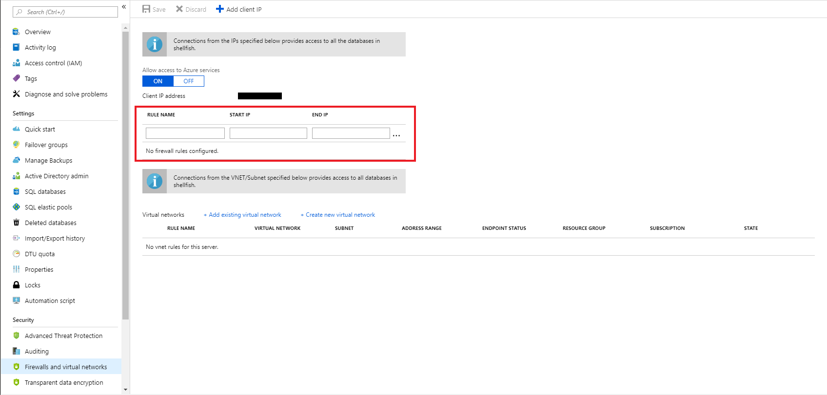
Firewall configuration on the portal
Synapse SQL (provisioned) > Security > Network Security > Firewalls
By default, Azure blocks all external connections to port 1433
Configure with the following steps:
Azure Synapse Analytics Resource: Server name > Firewalls and virtual networks
Notes:
Objective: The first line of defense when controlling access to Microsoft Azure SQL Data Warehouse involves IP address and port filtering on the Azure SQL Server instance level, implemented as firewall rules defined in its master database.
Talking Points:
The firewall restricts incoming traffic to TCP port 1433 only. In addition, by default, all external (from the Azure point of view) connections are blocked, so you need to explicitly enable them by specifying the public IP address (or IP address range) assigned to your Internet entry point.
Azure Portal

Slide 84
Firewall configuration using REST API
Synapse SQL (provisioned) > Security > Network security > Firewalls
Managing firewall rules through REST API must be authenticated.
For information, see Authenticating Service Management Requests.
Server-level rules can be created, updated, or deleted using REST API.
To create or update a server-level firewall rule, execute the PUT method.
To remove an existing server-level firewall rule, execute the DELETE method.
To list firewall rules, execute the GET.
PUT https://management.azure.com/subscriptions/{subscriptionId}/resourceGroups/{resourceGroupName}/providers/Microsoft.Sql/servers/{serverName}/firewallRules/{firewallRuleName}?api-version=2014-04-01REQUEST BODY
{
"properties": {
"startIpAddress": "0.0.0.3",
"endIpAddress": "0.0.0.3"
}
}
DELETE https://management.azure.com/subscriptions/{subscriptionId}/resourceGroups/{resourceGroupName}/providers/Microsoft.Sql/servers/{serverName}/firewallRules/{firewallRuleName}?api-version=2014-04-01
GET https://management.azure.com/subscriptions/{subscriptionId}/resourceGroups/{resourceGroupName}/providers/Microsoft.Sql/servers/{serverName}/firewallRules/{firewallRuleName}?api-version=2014-04-01
Notes:
Objective: Microsoft Azure SQL Database uses firewall rules to allow connections to your servers and databases. You can define server-level and database-level firewall settings for the master or a user database in your Azure SQL Database server to selectively allow access to the database.
Talking Points:
Microsoft Azure SQL Data Warehouse uses firewall rules to allow connections to your servers and databases. You can define server-level firewall settings using https://docs.microsoft.com/en-us/rest/api/sql/firewallrules
Manage server-level firewall rules through REST API
Managing firewall rules through REST API must be authenticated
Server-level rules can be created, updated, or deleted using REST API
To create or update a server-level firewall rule, execute the PUT method
To remove an existing server-level firewall rule, execute the DELETE method

Slide 85
Firewall configuration using PowerShell/T-SQL
Synapse SQL (provisioned) > Security > Network security > Firewalls
Windows PowerShell Azure cmdlets
New-AzureRmSqlServerFirewallRule
Get-AzureRmSqlServerFirewallRule
Set-AzureRmSqlServerFirewallRule
Transact SQL
sp_set_firewall_rule
sp_delete_firewall_rule
# PS Allow external IP access to SQL DW
PS C:\> New-AzureRmSqlServerFirewallRule
-ResourceGroupName "myResourceGroup" `
-ServerName $servername `
-FirewallRuleName "AllowSome"
-StartIpAddress "0.0.0.0"
-EndIpAddress "0.0.0.0“
-- T-SQL Allow external IP access to SQL DW
EXECUTE sp_set_firewall_rule
@name = N'ContosoFirewallRule’, @start_ip_address = '192.168.1.1’, @end_ip_address = '192.168.1.10'
Notes:
Objective: The first line of defense when controlling access to Microsoft Azure SQL DW involves IP address and port filtering on the Azure SQL Server instance level, implemented as firewall rules defined in its master database.
Talking Points:
In addition to the Azure Portal, firewall rules can be managed programmatically using Transact-SQL, REST API, and Azure PowerShell
Azure PowerShell
Get-AzureRmSqlServerFirewallRule Returns the current server-level firewall rules
New-AzureRmSqlServerFirewallRule Creates a new server-level firewall rule Set-AzureRmSqlServerFirewallRule Updates the properties of an existing server-level firewall rule
Remove-AzureRmSqlServerFirewallRule Removes server-level firewall rules
Transact-SQL
sp_set_firewall_rule -Creates or updates server-level firewall rules
sp_delete_firewall_rule- Deletes the firewall rule
Source: https://docs.microsoft.com/en-us/azure/sql-database/sql-database-firewall-configure?toc=%2Fazure%2Fsql-data-warehouse%2Ftoc.json#manage-firewall-rules-using-transact-sql

Slide 86
Managed VNet
Overview
Creating a workspace with a Managed workspace VNet associated with it ensures that user’s workspace is network isolated from other workspaces. The VNet associated with your workspace is managed by Azure Synapse. This VNet is called a Managed workspace VNet.
Benefits
With a Managed workspace customers can offload the burden of managing the VNet to Azure Synapse.
Customers don’t have to configure inbound NSG rules on their own VNets to allow Azure Synapse management traffic to enter their VNet.
Customers don't need to create a subnet for your Spark clusters based on peak load.
Managed workspace VNet along with Managed private endpoints protects against data exfiltration.

Slide 87
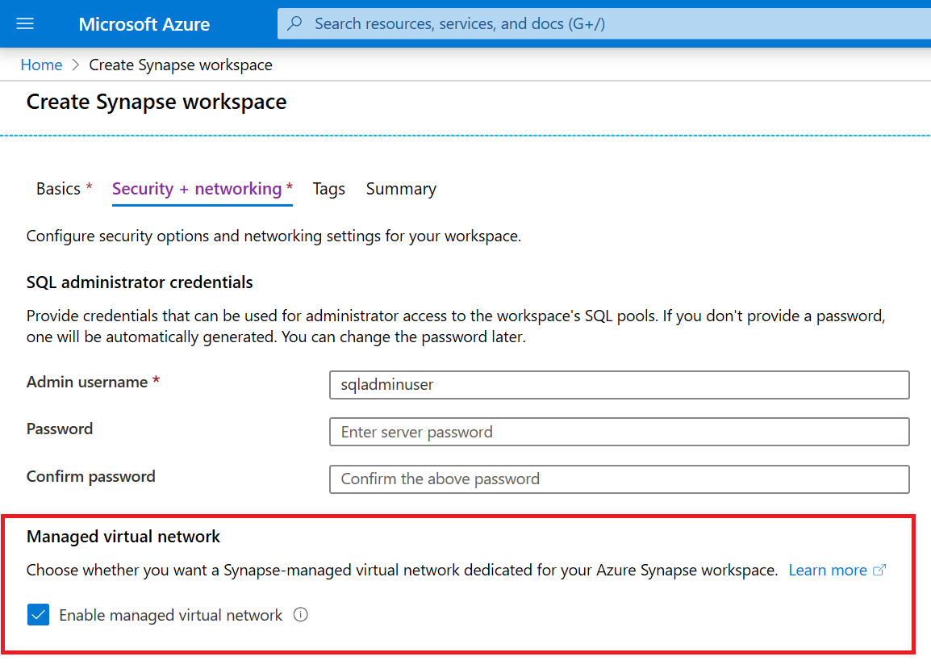
Managed VNet
Overview
During Azure Synapse workspace creation, user can choose to associate it to a managed VNet. User cannot change this workspace configuration after the workspace is created.
User cannot reconfigure a workspace that does not have a Managed workspace VNet associated with it and associate a VNet to it.
Private links are supported only in Synapse workspaces that have a managed VNet associated to it.

Slide 88
Private Endpoints
Overview
Managed private endpoints are private endpoints created in the Managed workspace VNet establishing a private link to Azure resources. Managed private endpoints are only supported in Azure Synapse workspaces with a Managed workspace VNet.
Benefits
Private link enables customers to access Azure services and Azure hosted customer/partner services from their Azure VNet securely.
With use of private link, traffic between customer’s VNet and workspace traverses entirely over the Microsoft backbone network.
Private link protects against data exfiltration risks.
Private endpoint uses a private IP address from customer’s VNet to effectively bring the service into their VNet.
Private endpoints are mapped to a specific resource in Azure and not the entire service.

Slide 89
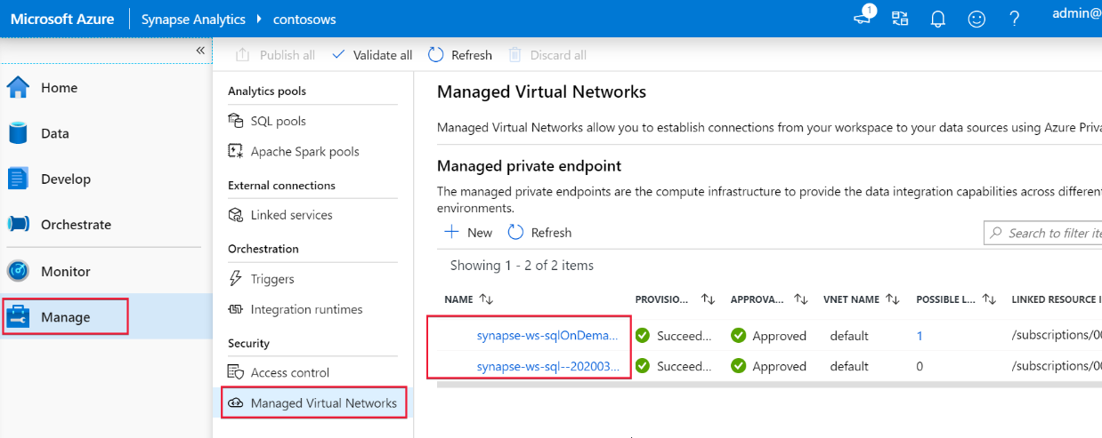
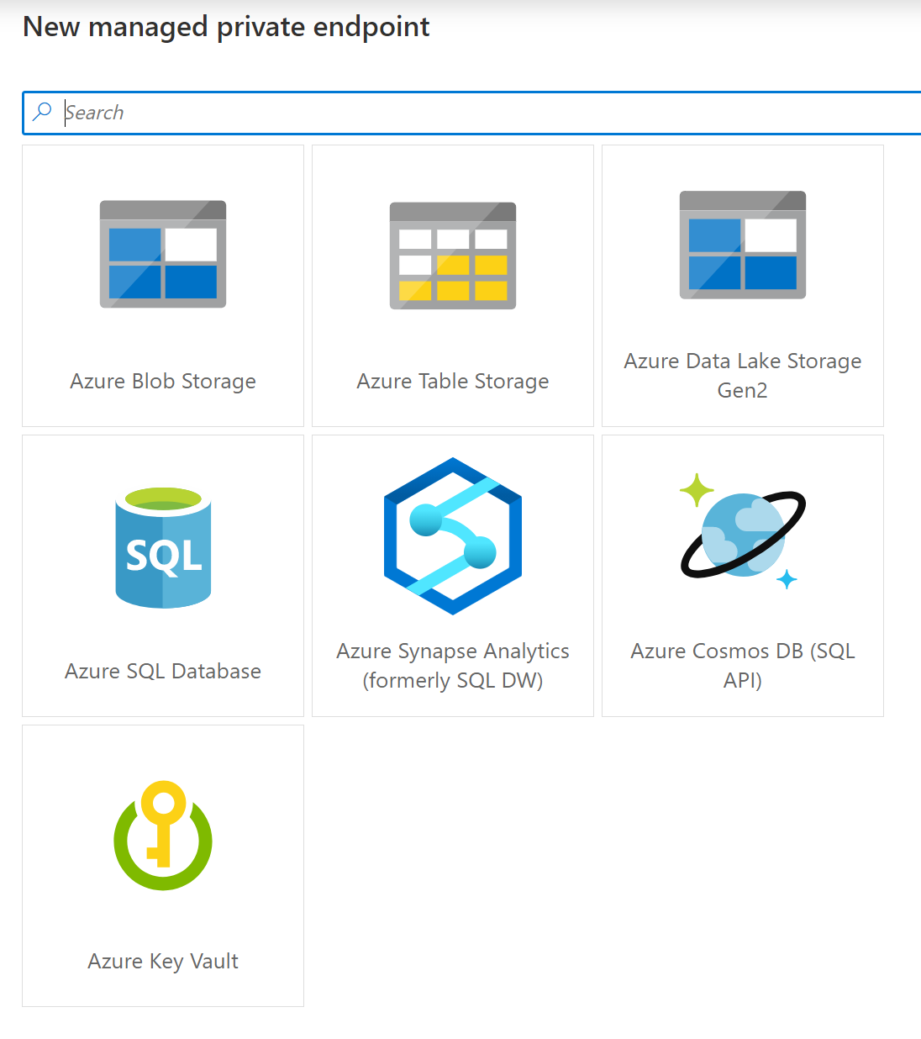
Private Endpoints for Synapse SQL (dedicated & serverless)
Dedicated SQL pool and serverless SQL pool use multi-tenant infrastructure that is not deployed into the Managed workspace VNet.
Azure Synapse creates two managed private endpoints to dedicated SQL pool and serverless SQL pool in that workspace. Customers do not get charged for these two Managed private endpoints.
Notes:
Managed private endpoints are private endpoints created in the Managed workspace Microsoft Azure Virtual Network establishing a private link to Azure resources. Azure Synapse manages these private endpoints on your behalf.
Only supported in Azure Synapse workspaces with a Managed workspace Virtual Network
Initially created in a “Pending” state in Azure Synapse, initiates an approval workflow, and can be approved/rejected by the Private link resource owner.
Only a Managed private endpoint in an approved state can send traffic to a given private link resource.

Slide 90

Managed VNets in the Synapse Workspace
The two Managed private endpoints to SQL pool and SQL on-demand automatically created in Synapse when the Managed workspace VNet is deployed.
Synapse Workspace
Managed VNet
Managed
private endpoint to SQL on-demand
Workspace
SQL on-demand
Synapse Studio
Managed
private endpoint to SQL Pool
Workspace
SQL Pool
Managed private endpoint
Spark Clusters
Other data sources
that support Private Link
(e.g. Cosmos DB,
Azure Storage, ADLS etc.)
The private endpoint establishes a private link between your
Azure Synapse Analytics workspace and your data sources where traffic between your VNet and workspace traverses entirely over the Microsoft backbone network.
IMPORTANT
All outbound traffic from the Managed workspace VNet will be blocked in the future. It's recommended that you connect to all your data sources using Managed private endpoints.
Internet

Slide 91
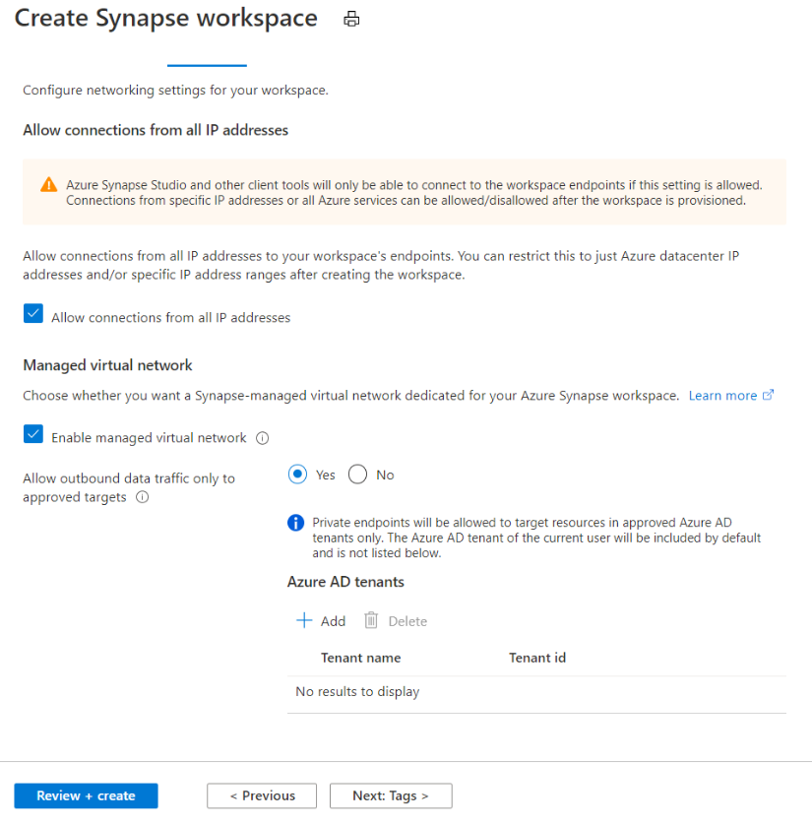
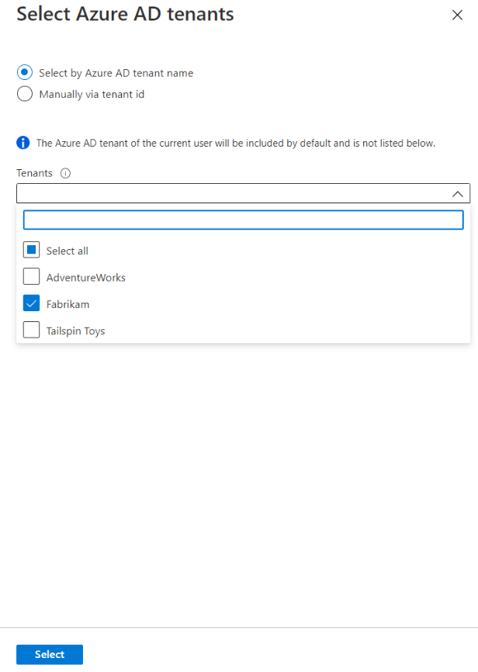

Data Exfiltration
Allow outbound data traffic over Synapse managed private endpoints to only approved tenants

Slide 92
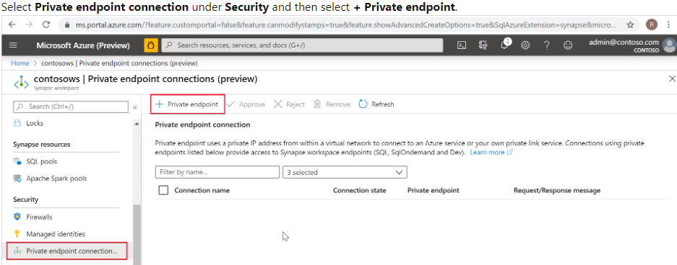

Connecting to Synapse from On-Premise
On-Premise VNet
Synapse Workspace
Managed VNet
SQL On-Demand tenant
*.sql.azuresynapse.net
Managed private endpoint to SQL on-demand
SQL Pool tenant
*-ondemand.sql.azuresynapse.net
Managed PE to SQL Pool
Dev tenant
*.dev.sql.azuresynapse.net
Azure VNET
Subnet
VPN Gateway
Private endpoint
Private endpoint
Private endpoint
site-to-site
point-to-site
Notes:
Check this article to learn how to create private endpoins to your Azure Synapse workspace: https://docs.microsoft.com/en-us/azure/synapse-analytics/security/how-to-connect-to-workspace-with-private-links

Slide 93

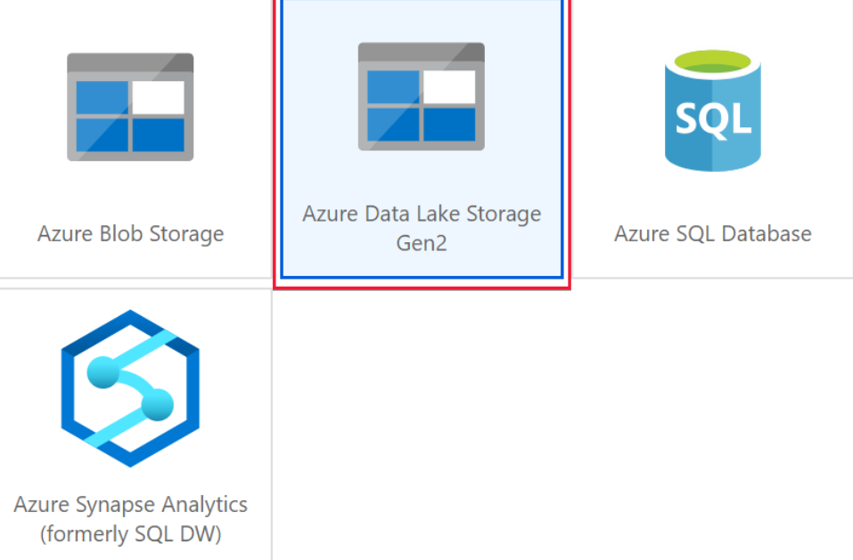
Self-hosted Integration Runtime in Synapse Workspace
Azure Data Factory
*.frontend.clouddatahub.net
Azure ServiceBus
*.servicebus.windows.net
Optional, required when using the staged copy feature
Self-hosted Integration Runtime
(on-premises)
Azure Storage
*.core.windows.net
Optional, required when the Self-hosted integration runtime has auto-update enabled
443
download.microsoft.com
Synapse Workspace
Azure
Integration Runtime
Self-Hosted
Integration Runtime
Managed VNET
Workspace
SQL on-demand endpoint
Synapse Studio
Private endpoint to SQL on-demand
Private endpoint to SQL Pool
Workspace
SQL Pool
endpoint
Private endpoint
Spark Clusters
Supports up to 4 nodes for high availability and scalability
Other data sources
that support Private Link
(e.g. Cosmos DB, Azure Storage etc.)
Internet

Slide 94
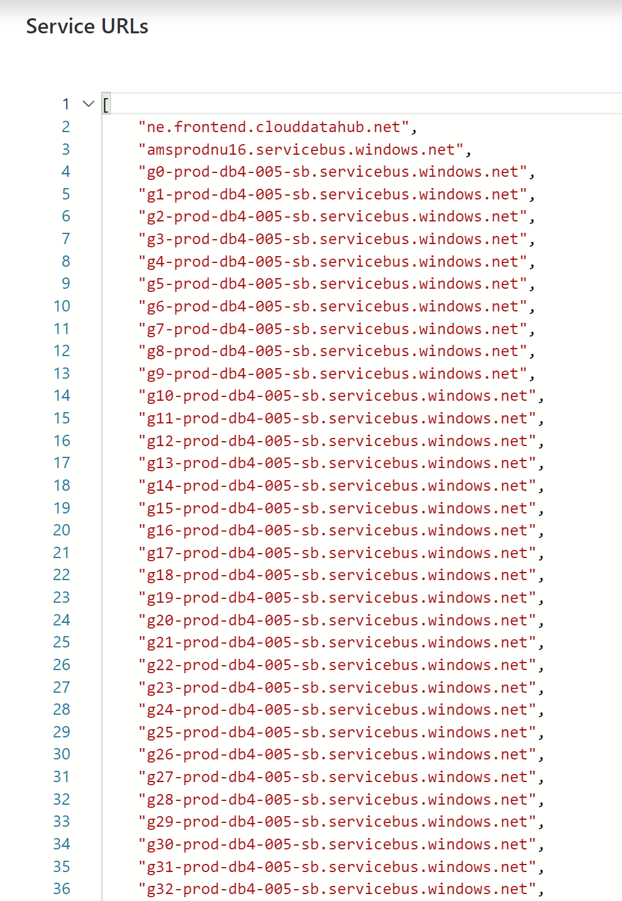
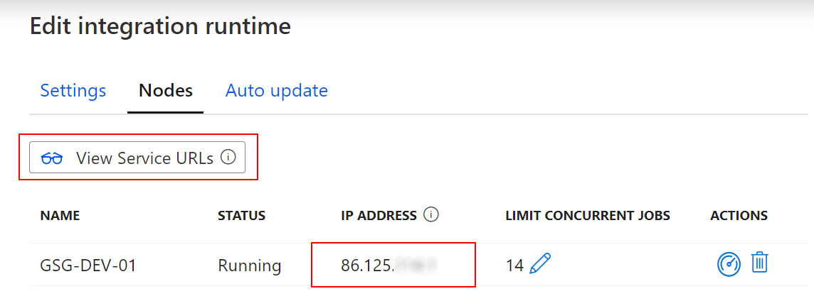
Self-hosted Integration Runtime in Synapse Workspace
Whitelisting of specific public Azure endpoints
Whitelisting of IR-specific IP addresses

Slide 95
Azure Active Directory authentication
Overview
Manage user identities in one location.
Enable access to Azure Synapse Analytics and other Microsoft services with Azure Active Directory user identities and groups.
Benefits
Enables management of database permissions by using external Azure Active Directory groups
Allows password rotation in a single place
Alternative to SQL Server authentication
Eliminates the need to store passwords
Azure Synapse Analytics
Notes:
Objective: Azure Active Directory authentication is a mechanism for connecting to Microsoft Azure SQL Database or Data Warehouse by using identities in Azure Active Directory. Azure SQL Database is used to refer to both SQL Database and SQL Data Warehouse in the para below.
Talking Points:
With Azure Active Directory authentication, you can centrally manage the identities of database users and other Microsoft services in a single location. Central identity management provides a single place to manage Azure SQL Database users and simplifies permission management. Benefits include:
An alternative to SQL Server authentication.
Help in stopping the proliferation of user identities across database servers.
The ability to perform password rotation in a single place.
Management of database permissions by using external Azure Active Directory groups.
Elimination of the need to store passwords: it enables integrated Windows authentication and other forms of authentication supported by Azure Active Directory.
Azure Active Directory authentication uses contained database users to authenticate identities at the database level.
Azure Active Directory members created in the managed domain or with a federated domain can be provisioned in Azure SQL Database.
Two-factor authentication or other forms of interactive authentication are supported.
Limitations:
Microsoft accounts (for example outlook.com, hotmail.com, live.com) or other guest accounts (for example gmail.com, yahoo.com) are not supported.
Only one Azure Active Directory administrator (a user or group) can be configured for an Azure SQL Database at any time.
Only an Azure Active Directory administrator can initially connect to the Azure SQL Database by using an Azure Active Directory account. The Azure Active Directory administrator can configure subsequent Azure Active Directory database users.
Some tools, like business intelligence (BI) and Microsoft Office Excel, are not supported.
Azure Active Directory authentication is supported by .NET Framework Data Provider for SQL Server (at least version in .NET Framework version 4.6).
Therefore SQL Server Management Studio (available with SQL Server 2016) and data-tier applications (DAC and .bacpac) can connect.
ODBC version 13.1 supports Azure Active Directory authentication
The sqlcmd.exe supports Azure Active Directory authentication beginning with version 13.1
PolyBase cannot authenticate by using Azure AD authentication.
Microsoft JDBC Driver 6.0 for SQL Server supports Azure AD authentication.
https://docs.microsoft.com/en-us/azure/sql-database/sql-database-aad-authentication
MFA related:
https://docs.microsoft.com/en-us/azure/sql-database/sql-database-ssms-mfa-authentication?toc=/azure/sql-data-warehouse/toc.json
https://docs.microsoft.com/en-us/sql/ssdt/azure-active-directory?view=azuresqldb-current
https://docs.microsoft.com/en-us/sql/tools/sqlcmd-utility?view=sql-server-2017
https://docs.microsoft.com/en-us/sql/tools/bcp-utility?view=sql-server-2017

Slide 96
Azure Active Directory trust architecture
Azure Active Directory and Azure Synapse Analytics
On-premises Active Directory
ADFS
Azure Active Directory
Azure SQL Database
SQL Server Management Suite
ADALSQL
ADO .NET 4.6
SQL Server Data Tools
Azure Active Directory Authentication Library for SQL Server (ADALSQL)
App
Notes:
Objective: Trust architecture between Azure Active Directory and Azure Synapse Analytics
Talking Points:
Azure Active Directory authentication is a mechanism of connecting to Microsoft Azure SQL Data Warehouse by using identities in Azure Active Directory (Azure AD). With Azure Active Directory authentication you can centrally manage the identities of database users and other Microsoft services in one central location. Central ID management provides a single place to manage database users and simplifies permission management. Benefits include the following:
It provides an alternative to SQL authentication.
Helps stop the proliferation of user identities across database servers.
Allows password rotation in a single place
Customers can manage database permissions using external (AAD) groups.
It can eliminate storing passwords by enabling integrated Windows authentication and other forms of authentication supported by Azure Active Directory.
Azure Active Directory authentication uses contained database users to authenticate identities at the database level.
Azure Active Directory supports token-based authentication for applications token-based authentication for applications connecting to SQL Database.
Source: https://docs.microsoft.com/en-us/azure/sql-database/sql-database-aad-authentication

Slide 97




Single Sign-On
Azure Synapse Analytics > Security > Authentication
Synapse Foundation Components
Synapse Linked Services
Implicit authentication - User provides login credentials once to access Azure Synapse Workspace
AAD authentication - Azure Synapse Studio will request token to access each linked services as user. A separate token is acquired for each of the below services:
ADLS Gen2
Azure Synapse Analytics
Power BI
Spark – Spark Livy API
management.azure.com – resource provisioning
Develop artifacts – dev.workspace.net
Graph endpoints
MSI authentication - Orchestration uses workspace MSI auth for automation
1. Request web.azuresynapse.net
2. Redirect to Auth Server / Authentication Screen
Cookies?
5. Original URL request + Token
6. Access Validation/ Token Verification
3. Credentials
Azure Active Directory
4. Token/ Redirect to Original Server
7. web.azuresynapse.net
Azure Synapse Studio
Orchestration
MSI Auth
Linked Service
Token to access service
Azure Synapse Analytics
Spark
Azure Data Lake Storage Gen2
Power BI

Slide 98
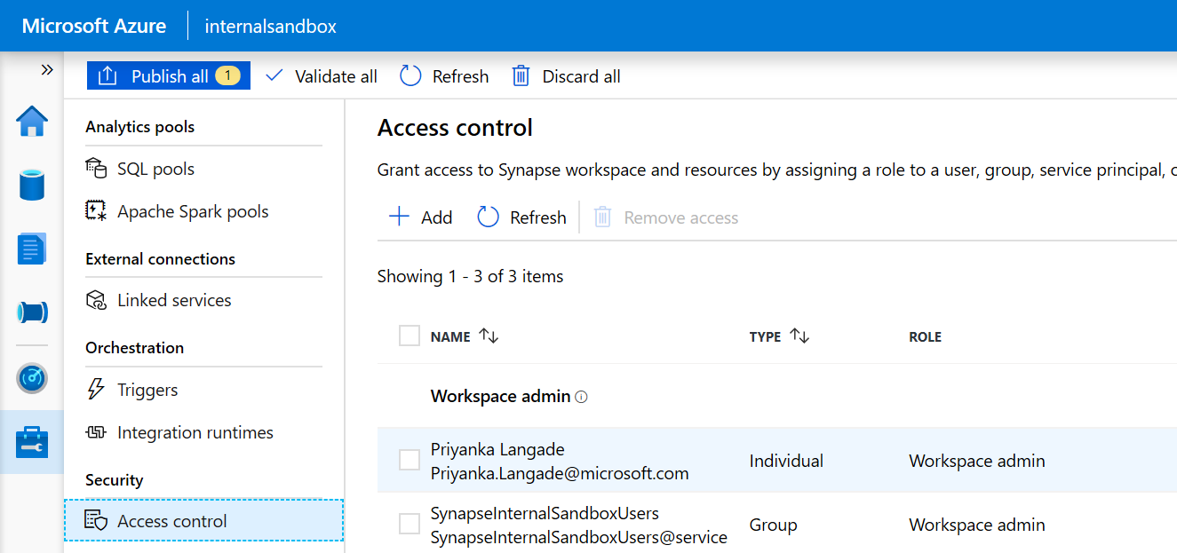
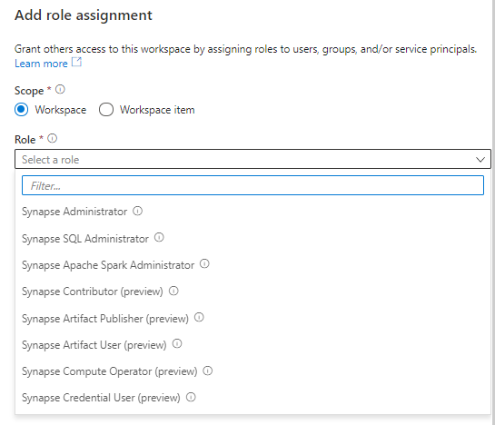
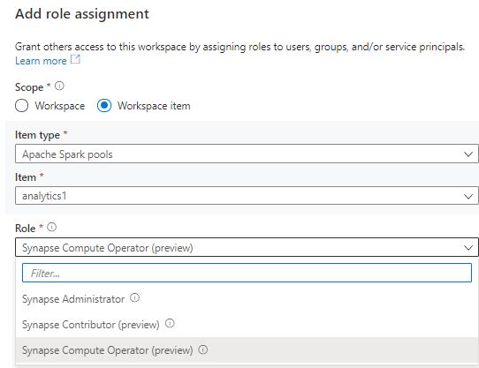
Access Control
Overview
It provides access control management to workspace resources and artifacts

Slide 99
Synapse RBAC Roles and permitted actions
Action | Synapse Administrator | Synapse Contributor | Synapse Artifact Author | Synapse Artifact Reader | Synapse Compute Manager | Synapse Credential User | Synapse Managed Private Endpoint Administrator | Synapse Reader
workspaces/read | Yes | Yes | Yes | Yes | Yes | Yes | Yes | Yes
workspaces/roleAssignments/write, delete | Yes
workspaces/managedPrivateEndpoint/write, delete | Yes |  |  |  |  |  | Yes
workspaces/bigDataPools/useCompute/action | Yes | Yes |  |  | Yes
workspaces/bigDataPools/viewLogs/action | Yes | Yes |  |  | Yes
workspaces/integrationRuntimes/useCompute/action | Yes | Yes |  |  | Yes
workspaces/integrationRuntimes/viewLogs/action | Yes | Yes |  |  | Yes
workspaces/artifacts/read | Yes | Yes | Yes | Yes
workspaces/notebooks/write, delete | Yes | Yes | Yes
workspaces/sparkJobDefinitions/write, delete | Yes | Yes | Yes
workspaces/sqlScripts/write, delete | Yes | Yes | Yes
workspaces/dataFlows/write, delete | Yes | Yes | Yes
workspaces/pipelines/write, delete | Yes | Yes | Yes
workspaces/triggers/write, delete | Yes | Yes | Yes
workspaces/datasets/write, delete | Yes | Yes | Yes
workspaces/libraries/write, delete | Yes | Yes | Yes
workspaces/linkedServices/write, delete | Yes | Yes | Yes
workspaces/credentials/write, delete | Yes | Yes | Yes
workspaces/notebooks/viewOutputs/action | Yes | Yes
workspaces/pipelines/viewOutputs/action | Yes | Yes
workspaces/linkedServices/useSecret/action | Yes |  |  |  |  | Yes
workspaces/credentials/useSecret/action | Yes |  |  |  |  | Yes
Notes:
Synapse RBAC roles - Azure Synapse Analytics | Microsoft Docs

Slide 100
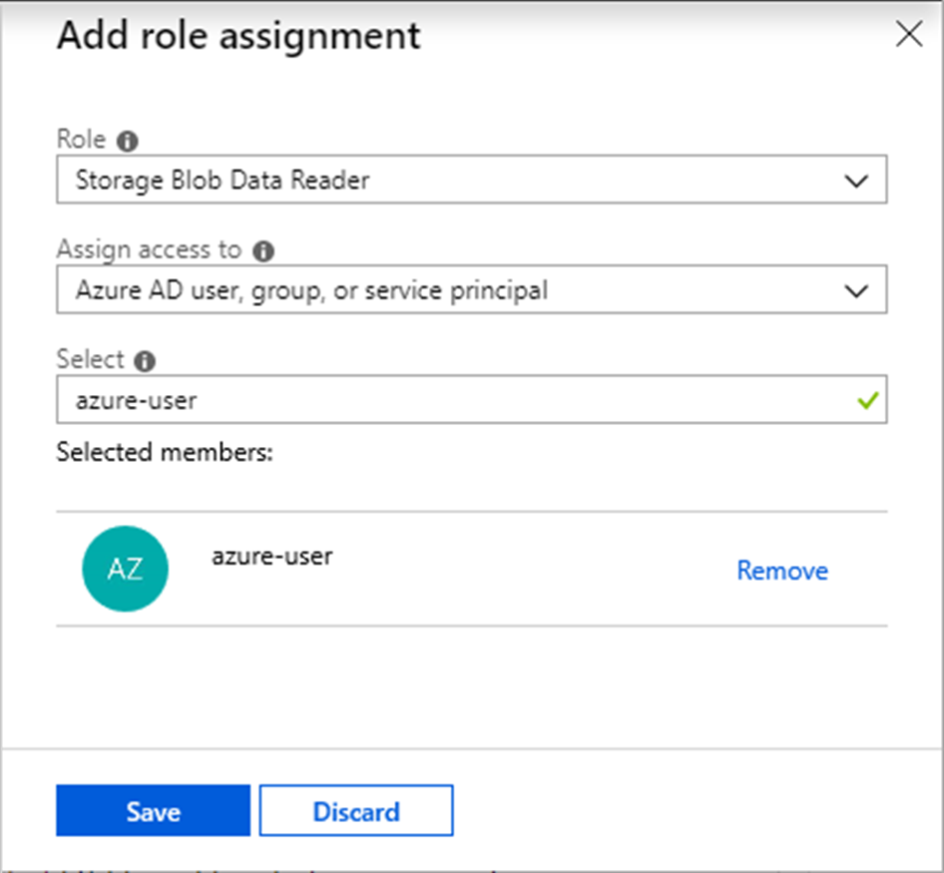
Access control – serverless SQL pool
--Create Login to a a single serverless SQL pool database
CREATE LOGIN [alias@domain.com] FROM EXTERNAL PROVIDER;
-- create user under that login
use yourdb -- Use your DB name
go
CREATE USER alias FROM LOGIN [alias@domain.com];
To grant full access to a user to all serverless SQL pool databases
CREATE LOGIN [alias@domain.com] FROM EXTERNAL PROVIDER;
ALTER SERVER ROLE sysadmin ADD MEMBER [alias@domain.com];
-- enable impersonation using workspace Managed Identity
CREATE CREDENTIAL [ManagedIdentity]
WITH IDENTITY = ‘Managed Identity’
-- enable access to specified storage using SAS token
CREATE CREDENTIAL [https://XXX.blob.core.windows.net/csv]
WITH IDENTITY = ‘SHARED ACCESS SIGNATURE’, SECRET = ‘sv=2014-02-14&sr=b&si=TestPolicy&sig=o%2B5%2F0C%2BLm7tWWft’
-- grant login1 to use SAS token defined in credential for storage account
GRANT REFERENCES CREDENTIAL::[https://XXX.blob.core.windows.net/csv]
TO LOGIN = ‘login1’
-- grant login2 to use Managed Identity
GRANT REFERENCES CREDENTIAL::[ManagedIdentity]
TO LOGIN = ‘login2’
-- grant login2 to select external data via table
GRANT SELECT ON OBJECT::[dbo.population] TO LOGIN = ‘login2’
Overview
Enterprise-grade security model enables you to control who can access data.
Benefits
Use Azure Active Directory users or native SQL logins.
SAS tokens, AAD or workspace identity access
Specify access methods in credential
Grant access to storage by referencing storage credential
Enable some logins to access external tables
Add AAD role assignments directly on Azure storage.

Slide 101





Enterprise-grade security
VNet
Azure Synapse Analytics
Data Protection
Access Control
Authentication
Network Security
Threat Protection
Defense-in-Depth
Notes:
- Azure SQL Data Warehouse (SQL DW) has industry-leading security capabilities with defense in-depth security model.
- Azure SQL Data Warehouse is built on top of SQL Server engine that’s proven to be great for the last 25 years!
- Also Azure SQL Data Warehouse shares infrastructure that Azure SQL Database is built upon.
Based on your feedback and what’s critical for you, we’ve been enabling various security capabilities with Azure SQL Data Warehouse that you may be already familiar with SQL Server and Azure SQL Database.
Diagram on this slide shows various security layers that enable you to solve critical security challenges.
- To add, Azure SQL has more compliance certifications than any other cloud provider and also meets GDPR regulations.

Slide 102




























Industry-leading compliance
ISO 27001
SOC 1 Type 2
SOC 2 Type 2
PCI DSS Level 1
Cloud Controls Matrix
ISO 27018
Content Delivery and Security Association
Shared
Assessments
FedRAMP JAB P-ATO
HIPAA / HITECH
FIPS 140-2
21 CFR
Part 11
FERPA
DISA Level 2
CJIS
IRS 1075
ITAR-ready
Section 508 VPAT
European Union
Model Clauses
EU Safe Harbor
United Kingdom
G-Cloud
China Multi
Layer Protection Scheme
China
GB 18030
China
CCCPPF
Singapore
MTCS Level 3
Australian Signals
Directorate
New Zealand
GCIO
Japan
Financial Services
ENISA
IAF

Slide 103
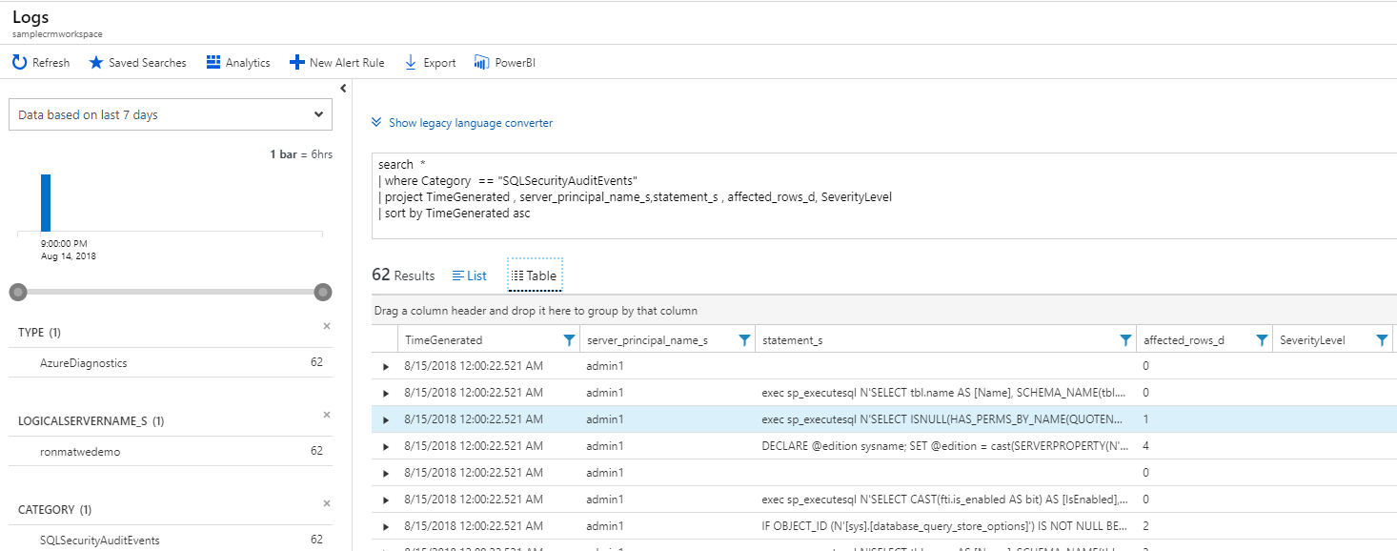
SQL auditing in Azure Log Analytics and Event Hubs Gain insight into database audit log
Configurable via audit policy
SQL audit logs can reside in
Azure Storage account
Azure Log Analytics
Azure Event Hubs
Rich set of tools for
Investigating security alerts
Tracking access to sensitive data
Log Analytics
Power BI
Dashboards
Event Hubs
Azure Synapse Analytics
Audit Log
Blob Storage
Developer
(1) Turn on SQL Auditing
(2) Analyze audit log
Notes:
SQL Auditing logs can now be written directly to Azure Log Analytics or Azure Event Hubs.
You can simply configure this from Azure portal and centrally manage all audit logs in one place.
In addition, it provides a rich set of tools for analyzing database audit logs: Log Analytics, Power BI and Custom Dashboards.
It is super helpful for investigating security alerts or for tracking access to your sensitive data.

Slide 104
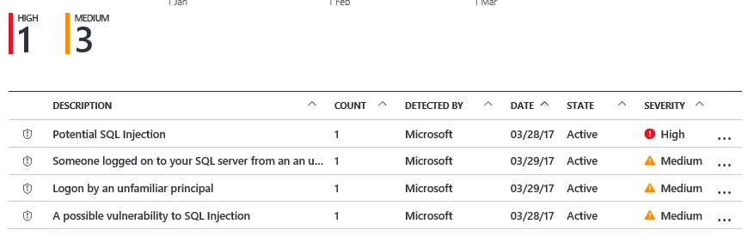

SQL threat detection Detect and investigate anomalous database activity
Detects potential SQL injection attacks
Detects unusual access & data exfiltration activities
Actionable alerts to investigate & remediate
View alerts for your entire Azure tenant using Azure Security Center
Attacker
(2) Possible threat to
access / breach data
User
Apps
Azure Synapse Analytics
Developer
Audit Log
Threat Detection
(1) Turn on Threat Detection
(3) Real-time actionable alerts
Notes:
SQL Threat Detection allows you to respond to unusual and harmful attempts to breach your database.
1) It is super simple to enable and requires no modifications to your application code.
2) It provides you with a set of world-class algorithms that learn, profile and detect potential SQL injections and unusual behavior patterns.
3) It triggers security alerts upon detection, which include clear description and actionable investigation and remediation steps.

Slide 105
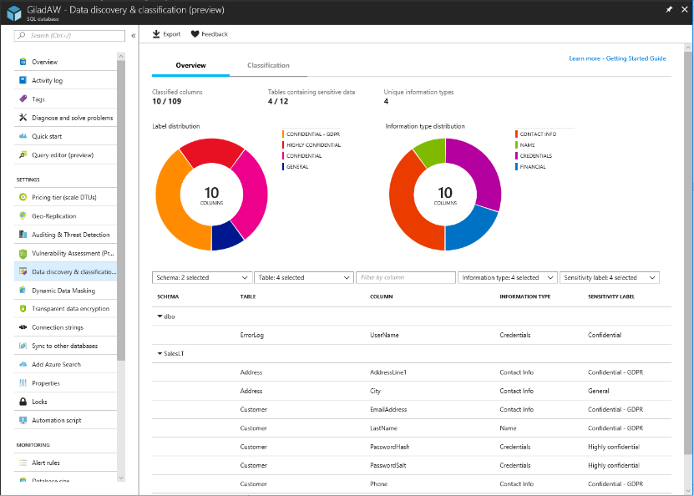
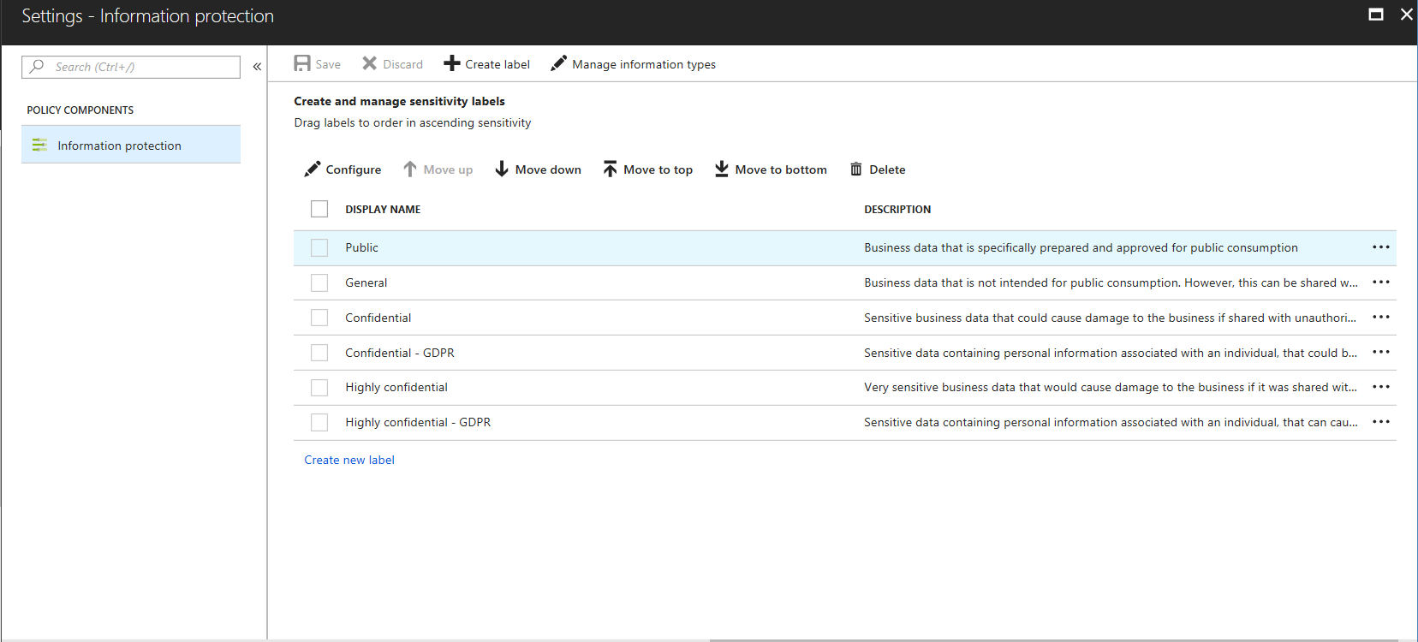
SQL Data Discovery & Classification Discover, classify, protect and track access to sensitive data
Automatic discovery of columns with sensitive data
Add persistent sensitive data labels
Audit and detect access to the sensitive data
Manage labels for your entire Azure tenant using Azure Security Center
Notes:
SQL Data Classification is a new feature in the Public Preview, that:
Automatically discovers columns containing potentially sensitive data
It provides a simple way to review and apply the classification recommendations through the Azure portal.
The sensitive data labels are persisted in the database (metadata attributes) and it audits and detects access to the sensitive data.
We offer built-in set of labels and information types, however customers can chose to define custom labels across Azure tenant using Azure Security Center

Slide 106
Object-level security (tables, views, and more)
Overview
GRANT controls permissions on designated tables, views, stored procedures, and functions.
Prevent unauthorized queries against certain tables.
Simplifies design and implementation of security at the database level as opposed to application level.
-- Grant SELECT permission to user RosaQdM on table Person.Address in the AdventureWorks2012 database
GRANT SELECT ON OBJECT::Person.Address TO RosaQdM;
GO
-- Grant REFERENCES permission on column BusinessEntityID in view HumanResources.vEmployee to user Wanida
GRANT REFERENCES(BusinessEntityID) ON OBJECT::HumanResources.vEmployee to Wanida with GRANT OPTION;
GO
-- Grant EXECUTE permission on stored procedure HumanResources.uspUpdateEmployeeHireInfo to an application role called Recruiting11
USE AdventureWorks2012;
GRANT EXECUTE ON OBJECT::HumanResources.uspUpdateEmployeeHireInfo TO RECRUITING 11;
GO
Notes:
Source: https://docs.microsoft.com/en-us/sql/t-sql/statements/grant-object-permissions-transact-sql?view=sql-server-2017

Slide 107

Row-level security (RLS)
Overview
Fine grained access control of specific rows in a database table.
Help prevent unauthorized access when multiple users share the same tables.
Eliminates need to implement connection filtering in multi-tenant applications.
Administer via SQL Server Management Studio or SQL Server Data Tools.
Easily locate enforcement logic inside the database and schema bound to the table.
Customer 1
Customer 2
Customer 3
SQL Data Warehouse
Notes:
Objective: Row-Level Security (RLS) simplifies the design and coding of security in your application.
Talking Points:
RLS enables you to implement restrictions on data row access. For example, ensuring that workers can access only those data rows that are pertinent to their department, or restricting a customer's data access to only the data relevant to their company.
The access restriction logic is located in the database tier rather than away from the data in another application tier. The database system applies the access restrictions every time that data access is attempted from any tier. This makes your security system more reliable and robust by reducing the surface area of your security system.
Implement RLS by using the CREATE SECURITY POLICY Transact-SQL statement, and predicates created as inline table valued functions.
Source: https://docs.microsoft.com/en-us/sql/relational-databases/security/row-level-security?toc=%2Fazure%2Fsql-data-warehouse%2Ftoc.json&view=sql-server-2017

Slide 108
Row-level security
Creating policies
Filter predicates silently filter the rows available to read operations (SELECT, UPDATE, and DELETE).
The following examples demonstrate the use of the CREATE SECURITY POLICY syntax
-- The following syntax creates a security policy with a filter predicate for the Customer table
CREATE SECURITY POLICY [FederatedSecurityPolicy]
ADD FILTER PREDICATE [rls].[fn_securitypredicate]([CustomerId])
ON [dbo].[Customer];
-- Create a new schema and predicate function, which will use the application user ID stored in CONTEXT_INFO to filter rows.
CREATE FUNCTION rls.fn_securitypredicate (@AppUserId int)
RETURNS TABLE
WITH SCHEMABINDING
AS
RETURN (
SELECT 1 AS fn_securitypredicate_result
WHERE
DATABASE_PRINCIPAL_ID() = DATABASE_PRINCIPAL_ID('dbo') -- application context
AND CONTEXT_INFO() = CONVERT(VARBINARY(128), @AppUserId));
GO
Notes:
Objective: Row-level filtering of data selected from a table is enacted through a security predicate filter defined as an inline table valued function. The function is then invoked and enforced by a security policy. The policy can restrict the rows that may be viewed (a filter predicate), but does not restrict the rows that can be inserted or updated from a table (a blocking predicate). There is no indication to the application that rows have been filtered from the result set; if all rows are filtered, then a null set will be returned.
** Azure SQL Data Warehouse doesn’t yet support block predicates.
Talking Points:
Filter predicates are applied while reading data from the base table, and it affects all get operations: SELECT, DELETE (i.e. user cannot delete rows that are filtered), and UPDATE (i.e. user cannot update rows that are filtered, although it is possible to update rows in such way that they will be subsequently filtered). Blocking predicates are not available in this version of RLS, but equivalent functionality (i.e. user cannot INSERT or UPDATE rows such that they will subsequently be filtered) can be implemented using check constraints or triggers.
Filter predicates and security policies have the following behavior:
Define a security policy that filters the rows of a table. The application is unaware that any rows have been filtered for SELECT, UPDATE, and DELETE operations, including situations where all the rows have been filtered out. The application can INSERT any rows, regardless of whether or not they will be filtered during any other operation. Define a predicate function that joins with another table and/or invokes a function. The join/function is accessible from the query and works as expected without any additional permission checks.
Issue a query against a table that has a security predicate defined but disabled. Any rows that would have been filtered or restricted are not affected.
The dbo user, a member of the db_owner role, or the table owner queries against a table that has a security policy defined and enabled. Rows are filtered/restricted as defined by the security policy.
Attempts to alter the schema of a table bound by a security policy will result in an error. However, columns not referenced by the filter predicate can be altered.
Attempts to add a predicate on a table that already has one defined (regardless of whether it is enabled or disabled) results in an error.
Attempts to modify a function used as a predicate on a table within a security policy results in an error.
Defining multiple active security policies that contain non-overlapping predicates, succeeds.
Source: https://docs.microsoft.com/en-us/sql/relational-databases/security/row-level-security?view=sql-server-2017

Slide 109
Row-level security
Three steps:
Policy manager creates filter predicate and security policy in T-SQL, binding the predicate to the patients table.
App user (e.g., nurse) selects from Patients table.
Security policy transparently rewrites query to apply filter predicate.
Policy manager
CREATE FUNCTION dbo.fn_securitypredicate(@wing int)
RETURNS TABLE WITH SCHEMABINDING AS
return SELECT 1 as [fn_securitypredicate_result] FROM
StaffDuties d INNER JOIN Employees e
ON (d.EmpId = e.EmpId)
WHERE e.UserSID = SUSER_SID() AND @wing = d.Wing;
CREATE SECURITY POLICY dbo.SecPol
ADD FILTER PREDICATE dbo.fn_securitypredicate(Wing) ON Patients
WITH (STATE = ON)
Database
Security policy
Filter Predicate:
INNER JOIN…
Nurse
Patients
SELECT * FROM Patients
SEMIJOIN APPLY dbo.fn_securitypredicate(patients.Wing);
Application
SELECT * FROM Patients
SELECT Patients.* FROM Patients,
StaffDuties d INNER JOIN Employees e ON (d.EmpId = e.EmpId)
WHERE e.UserSID = SUSER_SID() AND Patients.wing = d.Wing;
Notes:
Talking Points:
Policy manager creates a filter predicate and security policy
App user (e.g., a nurse) selects from the patient’s table
The query is transparently rewritten to apply the filter predicate
Notice: No app changes!

Slide 110

Column-level security
Overview
Control access of specific columns in a database table based on customer’s group membership or execution context.
Simplifies the design and implementation of security by putting restriction logic in database tier as opposed to application tier.
Administer via GRANT T-SQL statement.
Both Azure Active Directory (AAD) and SQL authentication are supported.
Notes:
Objective: Column-Level Security (CLS) simplifies the design and coding of security in your application.
Use Cases
Some examples of how CLS is being used today:
A financial services firm allows only account managers to have access to customer social security numbers (SSN), phone numbers, and other personally identifiable information (PII).
A health care provider allows only doctors and nurses to have access to sensitive medical records while not allowing members of the billing department to view this data.
Source: https://docs.microsoft.com/en-us/azure/sql-data-warehouse/column-level-security

Slide 111
Column-level security
Three steps:
Policy manager creates permission policy in T-SQL, binding the policy to the Patients table on a specific group.
App user (for example, a nurse) selects from Patients table.
Permission policy prevents access on sensitive data.
Policy manager
Database
CREATE TABLE Patients (
PatientID int IDENTITY,
FirstName varchar(100) NULL,
SSN char(9) NOT NULL,
LastName varchar(100) NOT NULL,
Phone varchar(12) NULL,
Email varchar(100) NULL
);
Patients
Nurse
Application
SELECT * FROM Membership;
Msg 230, Level 14, State 1, Line 12
The SELECT permission was denied on the column 'SSN' of the object 'Membership', database 'CLS_TestDW', schema 'dbo'.
Permission policy
GRANT SELECT ON Patients (
PatientID, FirstName, LastName, Phone, Email
) TO Nurse;
Allow ‘Nurse’ to access all columns except for sensitive SSN column
Queries executed as ‘Nurse’ will fail if they include the SSN column
Notes:
Talking Points:
Policy manager creates permission policy on Nurse against Patients table
App user (e.g., a nurse) selects from the patient’s table
The query is rejected if it violates permission policy
* Notice: No app changes!

Slide 112
Dynamic Data Masking
Overview
Prevent abuse of sensitive data by hiding it from users
Easy configuration in new Azure Portal
Policy-driven at table and column level, for a defined set of users
Data masking applied in real-time to query results based on policy
Multiple masking functions available, such as full or partial, for various sensitive data categories (credit card numbers, SSN, etc.)
Table.CreditCardNo
4465-6571-7868-5796
4468-7746-3848-1978
4484-5434-6858-6550
SQL Database
Real-time data masking, partial masking
CreditCardNo
XXXX-XXXX-XXXX-5796
XXXX-XXXX-XXXX-1978
Notes:
Objective: Dynamic data masking limits sensitive data exposure by masking it to non-privileged users. Dynamic data masking helps prevent unauthorized access to sensitive data by enabling customers to designate how much of the sensitive data to reveal with minimal impact on the application layer. It’s a policy-based security feature that hides the sensitive data in the result set of a query over designated database fields, while the data in the database is not changed. Dynamic data masking is easy to use with existing applications, since masking rules are applied in the query results, and there is no need to modify existing queries.
Talking Points:
For example, a call center support person may identify callers by several digits of their social security number or credit card number, but those data items should not be fully exposed to the support person. A developer can define a masking rule to be applied to each query result that masks all but the last four digits of any social security number or credit card number in the result set. For another example, by using the appropriate data mask to protect personally identifiable information (PII) data, a developer can query production environments for troubleshooting purposes without violating compliance regulations.
Dynamic data masking limits the exposure of sensitive data and prevents accidental viewing by engineers that access directly databases for troubleshooting purposes or non-privileged application users. Dynamic data masking doesn’t aim to prevent privileged database users from connecting directly to the database and running exhaustive queries that expose pieces of the sensitive data. Dynamic data masking is complimentary to other SQL Server security features (auditing, encryption, row level security…) and it is highly recommended to enable them in addition in order to protect better the sensitive data in the database.
Since data is masked just before being returned to the user, changing the data type to an unmasked type will return unmasked data.
Dynamic data masking is available in SQL Server 2016 .However, to enable dynamic data masking, you must use trace flags 209 and 219. For SQL Database, see https://docs.microsoft.com/en-us/azure/sql-database/sql-database-dynamic-data-masking-get-started.
Source: https://msdn.microsoft.com/en-us/library/mt130841(v=sql.130).aspx

Slide 113
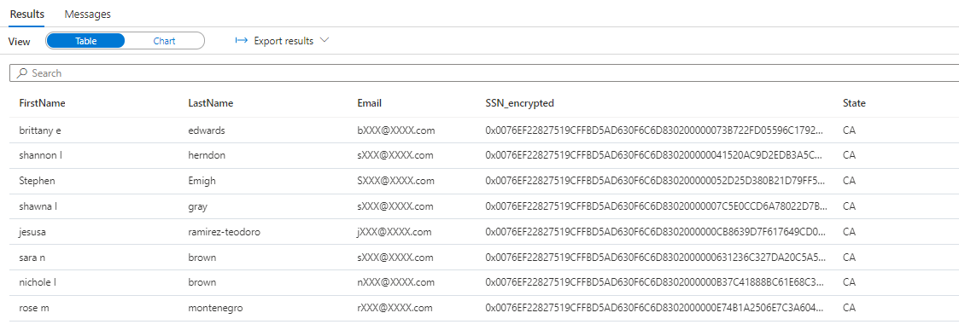
Column Level Encryption
Overview
It helps to implement fine-grained protection of sensitive data within a table in dedicated SQL pool.
The data in CLE enforced columns is encrypted on disk. User need to use DECRYPTBYKEY function to decrypt it.
5 step process to set up CLE
Create master key
Create certificate
Configure symmetric key for encryption
Encrypt the column data
Close symmetric key
Notes:
Encrypt a Column of Data - SQL Server & Azure Synapse Analytics & Azure SQL Database & SQL Managed Instance | Microsoft Docs

Slide 114
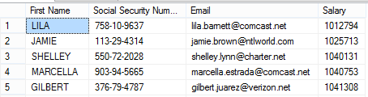
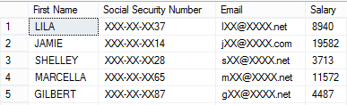
Dynamic Data Masking
Three steps
1. Security officer defines dynamic data masking policy in T-SQL over sensitive data in the Employee table. The security officer uses the built-in masking functions (default, email, random)
2. The app-user selects from the Employee table
3. The dynamic data masking policy obfuscates the sensitive data in the query results for non-privileged users
2
SELECT [First Name],
[Social Security Number],
[Email],
[Salary]
FROM [Employee]
Business app
3
Non-masked data (admin login)
ALTER TABLE [Employee]
ALTER COLUMN [SocialSecurityNumber]
ADD MASKED WITH (FUNCTION = 'DEFAULT()')
ALTER TABLE [Employee]
ALTER COLUMN [Email]
ADD MASKED WITH (FUNCTION = 'EMAIL()')
ALTER TABLE [Employee]
ALTER COLUMN [Salary]
ADD MASKED WITH (FUNCTION = 'RANDOM(1,20000)')
GRANT UNMASK to admin1
1
Security officer
Masked data (admin1 login)
Notes:
Objective: Dynamic data masking limits sensitive data exposure by masking it to non-privileged users.
Talking Points:
Dynamic data masking helps prevent unauthorized access to sensitive data by enabling customers to designate how much of the sensitive data to reveal with minimal impact on the application layer. It’s a policy-based security feature that hides the sensitive data in the result set of a query over designated database fields, while the data in the database is not changed.
For example shown above, a security officer defines the masking policy in T_SQL over sensitive data at Employee table . Any app user, issue select query from the Employee table but those data items should not be fully exposed. A masking rule can be defined that masks all but the last four digits of any Social Security number or credit card number in the result set of any query. As another example, an appropriate data mask can be defined to protect personally identifiable information (PII) data, so that a developer can query production environments for troubleshooting purposes without violating compliance regulation.

Slide 115
Types of data encryption
Data Encryption | Encryption Technology | Customer Value
In transit | Transport Layer Security (TLS) from the client to the server TLS 1.2 | Protects data between client and server against snooping and man-in-the-middle attacks
At rest | Transparent Data Encryption (TDE) for Azure Synapse Analytics | Protects data on the disk User or Service Managed key management is handled by Azure, which makes it easier to obtain compliance
In use
In transit
At rest
Column encryption
Customer data
Database files, backups, Tx log, TempDB
Notes:
Objective: Azure SQL DW includes several additional security measures for data. This slide provides an overview of SQL encryption in transit, at rest, and end-to-end.
Talking Points:
Key takeaway: Encrypted sensitive data and its corresponding keys are never seen in plain text in SQL Server
The customer will need to verify in the Azure Portal that the database is encrypted via PowerShell/T-SQL
Encryption-In-Transit technologies:
TLS from Client to Server
TLS = Transport Layer Security
Encryption at rest technologies:
TDE = Transparent Data Encryption
** SQL Data Warehouse doesn’t support Always-Encryption yet.

Slide 116
Transparent data encryption (TDE)
Overview
All customer data encrypted at rest
TDE performs real-time I/O encryption and decryption of the data and log files.
Service OR User managed keys.
Application changes kept to a minimum.
Transparent encryption/decryption of data in a TDE-enabled client driver.
Compliant with many laws, regulations, and guidelines established across various industries.
USE master;
GO
CREATE MASTER KEY ENCRYPTION BY PASSWORD = '<UseStrongPasswordHere>';
go
CREATE CERTIFICATE MyServerCert WITH SUBJECT = 'My DEK Certificate';
go
USE MyDatabase;
GO
CREATE DATABASE ENCRYPTION KEY
WITH ALGORITHM = AES_128
ENCRYPTION BY SERVER CERTIFICATE MyServerCert;
GO
ALTER DATABASE MyDatabase
SET ENCRYPTION ON;
GO
Notes:
Talking Points:
Fully managed by Azure
Support for user-managed TDE using Azure Key Vault
Simple Interface
Single SQL Statement/API call to enable/disable
Predictable Encryption Performance
Uses Azure SQL Database’s editions to ensure predictable performance
AES-NI Hardware Acceleration
Intel’s AES-NI support in TDE means better performance and better value

Slide 117
Transparent data encryption (TDE)
Key Vault
Benefits with User Managed Keys
Assume more control over who has access to your data and when.
Highly available and scalable cloud-based key store.
Central key management that allows separation of key management and data.
Configurable via Azure Portal, PowerShell, and REST API.
Azure Active Directory
2
Portal
1
Azure SQL Service
PowerShell
Rest API
Azure Key Vault
3
1
The Key Vault admin grants vault access to the SQL Database server using its unique Azure Active Directory (AD) identity
2
The server uses its Azure AD identity to authenticate with Azure AD for access to your Key Vault
3
The server sends get, wrap key, and unwrap key request to the asymmetric key in key Vault for database encryption key protection.
Notes:
Talking Points:
Fully managed by Azure
Support for user-managed TDE using Azure Key Vault
Simple Interface
Single SQL Statement/API call to enable/disable
Predictable Encryption Performance
Uses Azure SQL Database’s editions to ensure predictable performance
AES-NI Hardware Acceleration
Intel’s AES-NI support in TDE means better performance and better value

Slide 118
Thank You slide
Thank you

Slide 119


Breakout Activity: Security
Objective: As a result of attending this, you will better be able to apply security concepts including row level security, object level security, column level security, sensitive data discovery and classification and access controls to a customer scenario.
What you will be doing: Within your breakout group in Teams, you will collaborate with your peers on a shared whiteboard. As a team, you will review WWI requirements provided in student guide. Students will open the whiteboard and as a team answer the provided challenge questions. The questions will be pre-loaded into the whiteboard.
Total Activity Time: 60 minutes

Slide 120
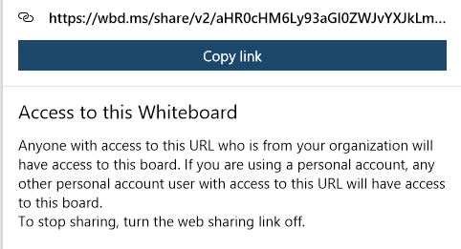
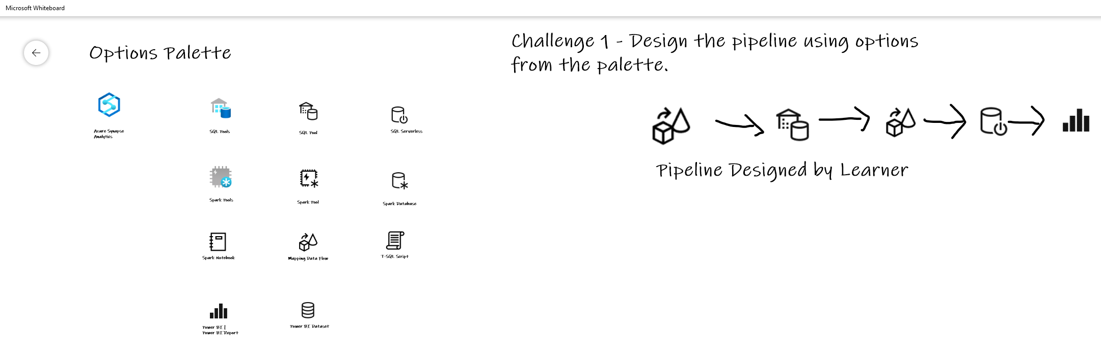
Activity: group-based whiteboard exercise
GUIDE:
Activity 04: Security
https://github.com/solliancenet/data-ai-technical-bootcamp/
Step 1: Go to your table group channel
Step 2: Your Learning Adviser will provide a whiteboard link
Step 3: Load the whiteboard and begin activity collaboration with your table group via a Microsoft Teams “meet now” call (meet now button in upper right corner of application)

Slide 121
Hands-On Build Activity: Security
Objective: As a result of participating in this activity, you will practice and be able to articulate several security-related steps that cover an end-to-end security story for Azure Synapse Analytics.
What you will be doing: This will be a chance for you to work individually in your lab environment to complete a set of tasks you would typically follow in work associated with ingesting and integrating your customer’s data. A set of tasks are outlined for you to follow and complete.
Total Activity Time: 60 minutes

Slide 122
Lab: individual lab exercise
Step 1: Go to your table group channel
Step 2: Your Learning Adviser will provide you a unique cloud lab login link
Step 3: Login and begin the lab. Engage your table group via a Microsoft Teams “meet now” call to support each other (meet now button in upper right corner of application)

Slide 123

Day 2 Wrap Up
Thank you for your participation in the Day 2 Technical Boot Camp
What was covered today:
Implement optimization strategizes for the data warehouse using SQL based approached in Azure Synapse Analytics.​
Apply security concepts including row level security, object level security, column level security, sensitive data discovery and classification and access controls to a customer scenario
What we will learn tomorrow:
Implement a process to train a machine learning model
Address scenarios to monitor and manage Azure solutions
If at anytime you require assistance please send a message to the “Need help – ask here” channel in the Microsoft Teams site for this event

Slide 124


We’d love to hear from you!
Day 1 | Day 2
Scan the QR code below using your smartphone or access the link https://aka.ms/BC_EMEA_Day1 You’ll also receive a link to this survey by email. You only need to complete it once. Answer the survey questions to provide your feedback on Day 1 of Boot Camp. Be honest. Every bit of feedback helps us improve. | Scan the QR code below using your smartphone or access the link https://aka.ms/BC_EMEA_Day2 You’ll also receive a link to this survey by email. You only need to complete it once. Answer the survey questions to provide your feedback on Day 2 of Boot Camp. Be honest. Every bit of feedback helps us improve.

